Slide 1
Statewide Rail Modernization & Network Integration
April 29, 2015

Slide 2
What is Rail Modernization?
Investment in new and improved services, with a strong focus on customer experience
Investment focused on improving efficiency
Shorter journey times
Improved reliability and capacity for all operators (passenger and freight)
Encourage full utilization of least expensive services
Modernization of operating agreements among rail operators in shared corridors
Capital investments lowering long-term and life-cycle costs
Rethinking use of existing assets
Long-term focus in planning to ensure best capital project prioritization

Slide 3
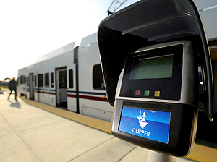
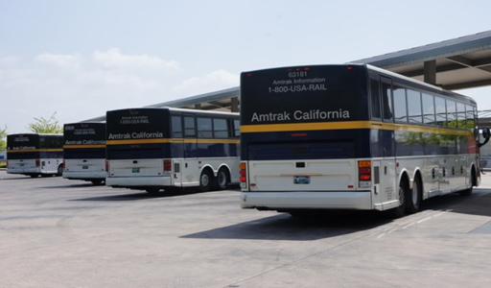
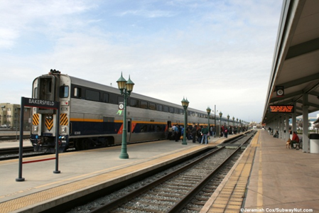
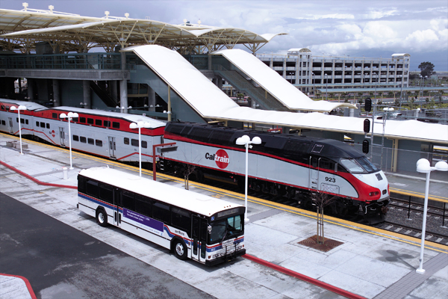
What is Network Integration?
Service that is planned, scheduled and operated as a network, with well-functioning connections
Customer-focused improvements to foster ease of payment and information
Long-term investments focused on improving the network as a whole – brand neutral and cost-effective
Improved Services & Improved Customer Experience

Slide 4
Importance of Multi-Agency and Intermodal Network Planning & Investment
LOSSAN South Slotted Schedule work (2014-15)
Integrated ticketing & network integration
Multi-state planning (FRA, AZ and NV)
Strategic service planning
Long-term planning documents
California Freight Mobility Plan (2014)
California Transportation Plan 2040 (2015)
Interregional Transportation Plan (2015)
Interregional Transportation Improvement Program (2016)
2016 HSR Business Plan
2018 State Rail Plan

Slide 5
Opportunities for Collaboration
Existing Funding Programs
Transit & Intercity Rail Capital Program
Changing Relationship with Amtrak driven by PRIIA Section 209
Increased state cost for Amtrak operations and pass-through capital costs
Increased state ownership of assets needed to deliver service
Network Integration Planning
2018 State Rail Plan

Slide 6
Network Integration Planning
Phase 1 – Strategic Assessment
Statewide Travel Demand Market Analysis
Rail Market Opportunities Workshop
Rail Infrastructure Review
Rail Network Opportunities Workshop
Phase 2A – Analysis Incorporated into 2018 State Rail Plan
Draft Statewide Rail Network Vision
Conceptual Service Goal Development
Ridership and Revenue Modeling
Operations and Service Planning
Rail System Network Analysis
Capital Improvements Analysis
Phase 2B – Governance and Implementation
Statewide Rail Structure, Organization, Roles & Responsibilities
Network Integration Elements
Transit Connectivity Planning

Slide 7
Statewide Infrastructure Assessment & 2018 State Rail Plan
Infrastructure Assessment underway
Stakeholder workshop expected July 8th
Work product complete by late fall 2015
2018 State Rail Plan
Procurement process underway
Selection expected before end of fiscal year (June 2015) – contract start date in July 2015
Full integration of 2016 HSR Business Plan
Public draft of State Rail Plan - March 1, 2017
Final State Rail Plan – May 2018

