Slide 1
A TRANSFORMATIVE INVESTMENT IN CALIFORNIA’S FUTURE
Dan Richard, Chair
California Passenger Rail Summit
April 29, 2015 Sacramento, CA

Slide 2
HIGH-SPEED RAIL: More Than A Transportation Program
California is the 8th Largest Economy in the World
Comparable to Northeast Corridor in Terms of Distance, Population and Complexity
Transformative Investment in our Transportation Network
Connecting all California Population Centers

Slide 3
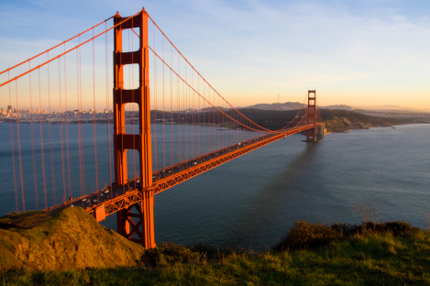
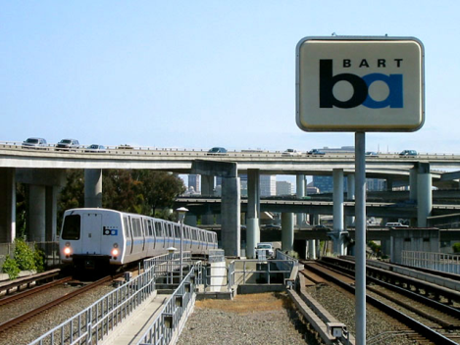
Challenges of transformative projects
Transformative Projects Have Never Been Easy
Golden Gate Bridge:
“Upside-Down Rat Trap that will Mar the Beauty of the Bay”
2,000 Plus Lawsuits
BART: Called the Train to Nowhere
University of California System &
California State Water Project:
Single Vote Margins
Where would California be without these?

Slide 4
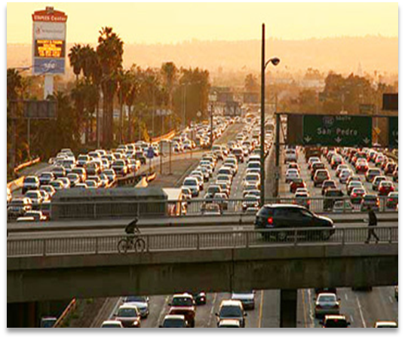
Why high-speed rail in California?
Curbs Congestion
LAX to SFO is the Busiest Short-Haul Market in US
1 in 6 Flights out of LA Heads to Bay Area
Six of Top 30 Congested Urban Areas in US Located in
California
Population Growth
Estimated to Reach 50 Million by 2050
Air Quality/Sustainability
Meets Goals of AB 32/SB 375
Worst Air Communities in the Country
Alternatives are Costly
2-3 Times More Expensive

Slide 5
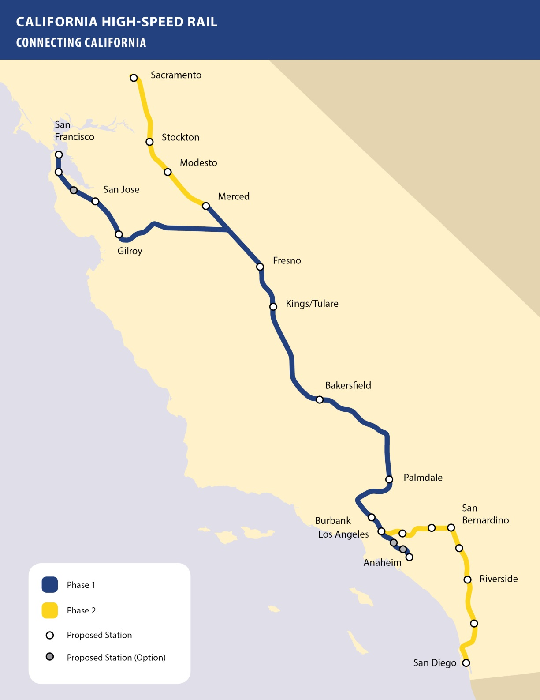
Connecting California
Initial Operation Section:
300 Miles
Merced to Burbank
Phase I:
520 Miles
San Francisco to Los Angeles/Anaheim
Regional Improvements
Caltrain Electrification
LA Union Station Passing Tracks
Positive Train Control
Grade Separation

Slide 6
Key program components
Must Provide a One-Seat Ride from SF to LA in 2 Hours and 40 Minutes
Must be Capable of Operating at Speeds up to 200 MPH
Must Operate Without a Subsidy
Must Connect the State’s Major Cities
Eventual Extensions to San Diego and Sacramento
Notes:
High-Speed rail concept through the Pacheco Pass

Slide 7
Connecting California
Our System will Tie California Economies Together:
Within & Between Regions
Smaller Cities to Major Markets
Expand Location Decisions
Link Suppliers, Manufactures, Shippers and Customers

Slide 8
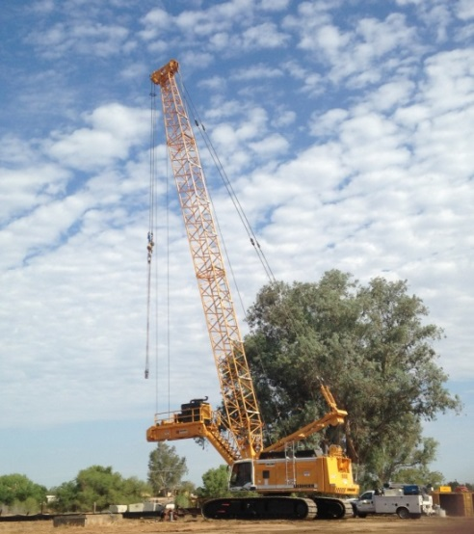
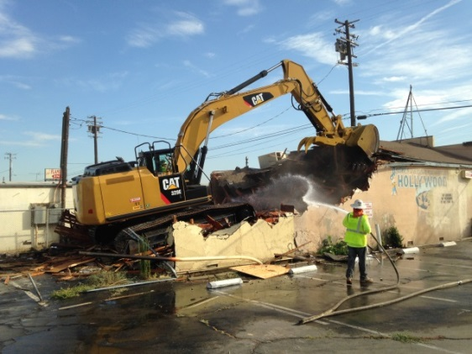
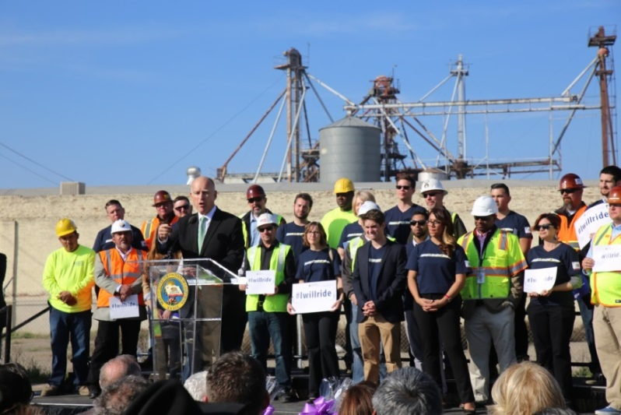
key PROGRAM milestones
Funding:
$3.3 Billion Federal and $4.7 Billion Prop 1A
25% of Future Cap and Trade Proceeds
Environmental Clearances:
Merced to Fresno: May 2012
Fresno to Bakersfield: June 2014
Construction Packages:
CP 1: Executed in August 2013, Under Estimates
CP 2-3: Contract Execution Expected in Spring 2015
CP4: Five Teams Qualified to Bid
Official Groundbreaking in January
Work is Underway

Slide 9
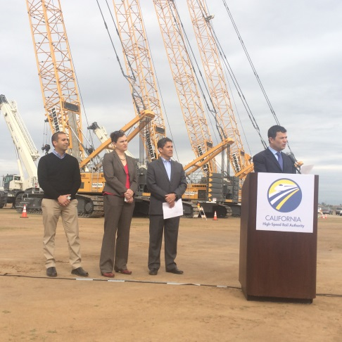
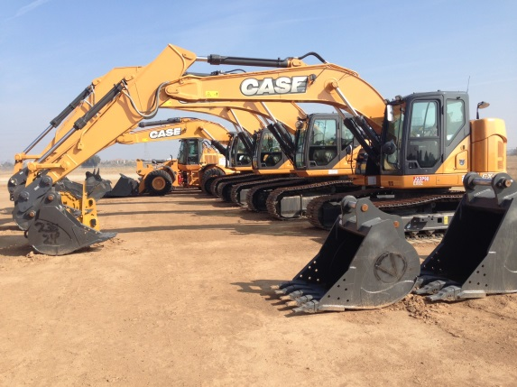
key environmental milestones
Conservation & Preservation of Agricultural Land
Department of Conservation Solicits Farmland Mitigation Proposals
5,000 Acres of Permanent Easements in the Central Valley
Tier 4 Construction Equipment:
Engines Meet Nation’s Most Stringent Standards
Substantial Mitigation Measures:
Lazy K Mitigation Site
RFP for Habitat Mitigation in Central Valley
Voluntary Emissions Reduction Agreement (VERA):
MOU with San Joaquin Unified Air Pollution Control District
Zero Net Emissions
Replaces Aging Equipment Including Tractors and Irrigation Pumps

Slide 10
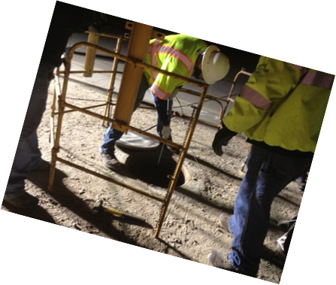
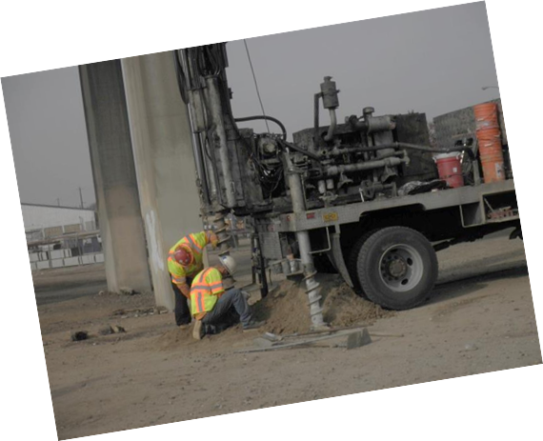
Connecting California: jobs
Targeting: California
Construction: Direct, Indirect Jobs
in Hard-Hit Sectors
Permanent: Rail Modernization
Creates Efficiencies Statewide and
Presents New Economic Opportunities

Slide 11
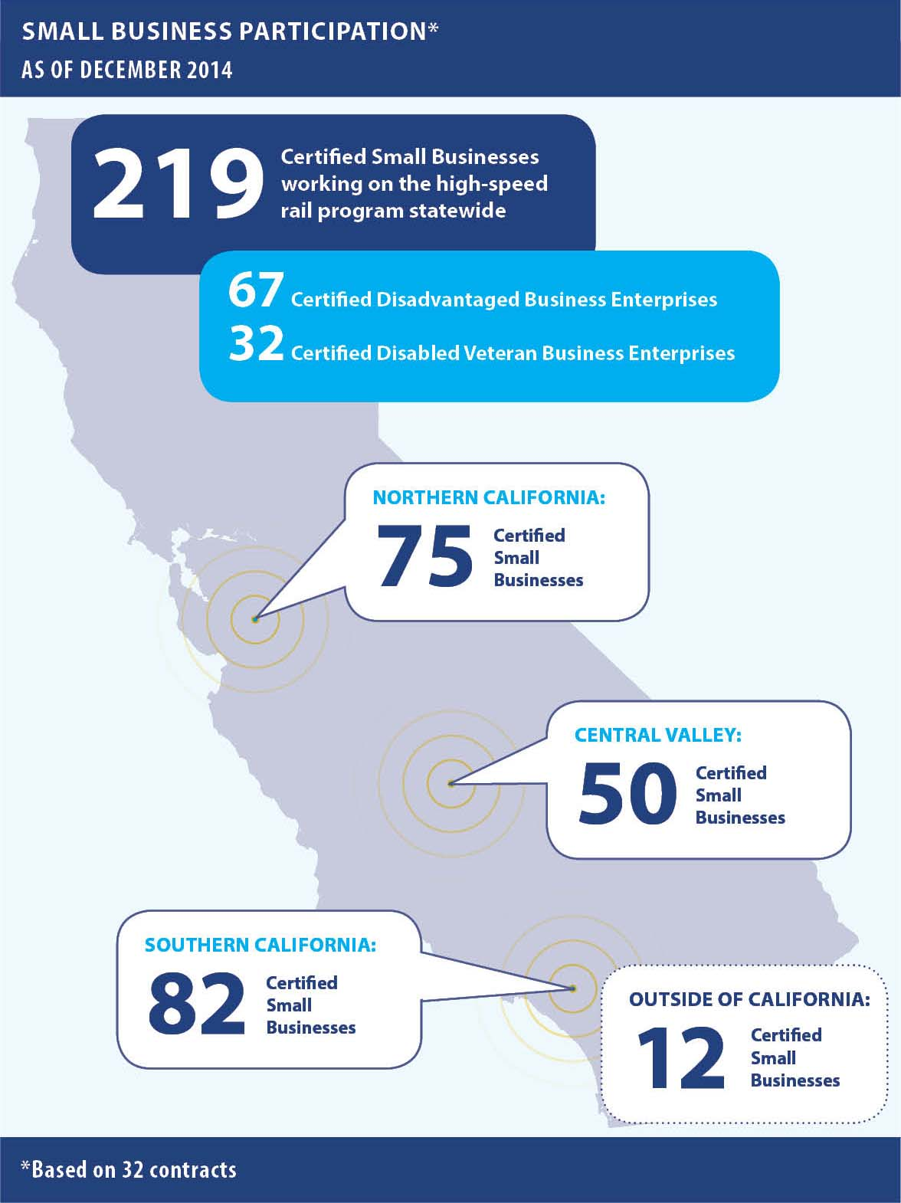
SMALL BUSINESS PROGRAM
30% Goal for Small Business Participation
10% Disadvantaged Business Enterprises (DBE)
3% Disabled Veteran Business Enterprises (DVBE)

Slide 12
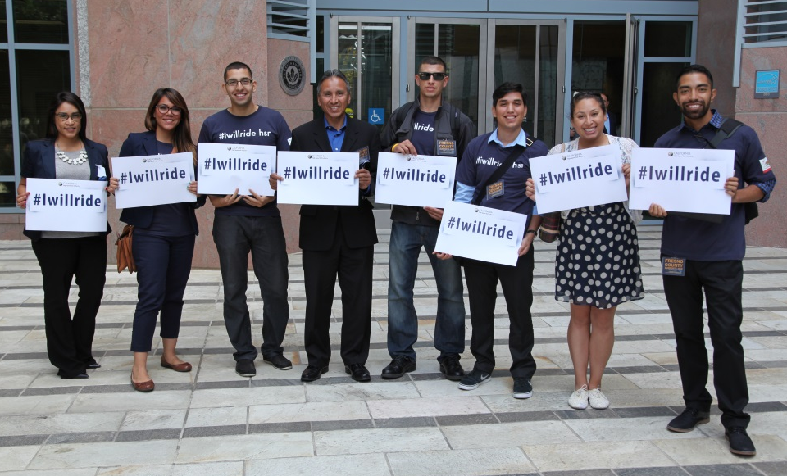
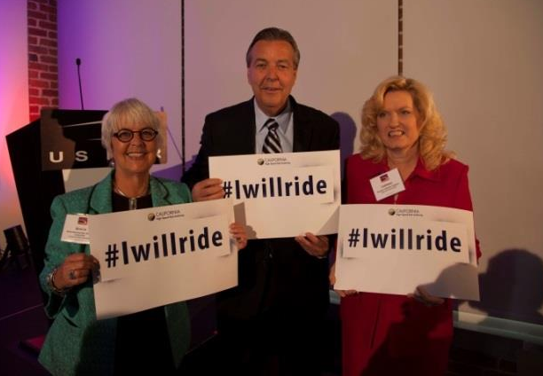
social media: #iwillride
Support and Educate Others on this
Transformative Investment in California’s Future
#Iwillride Social Media Campaign
Engage & Educate
#Iwillride Youth Advocacy Campaign
Increase Millennial Support

Slide 13
Thank you
Dan Richard, Board of Directors Chair
(916) 324-1541 boardmembers@hsr.ca.gov
Headquarters California High-Speed Rail Authority 770 L Street, Suite 800 Sacramento, CA 95814 www.hsr.ca.gov
facebook.com/CaliforniaHighSpeedRail
twitter.com/cahsra
youtube.com/user/CAHighSpeedRail

