Slide 1
Service Integration:
Service Integration for Our Grandkids
Jim Allison
Manager of Planning
Capitol Corridor

Slide 2

Service Conception - Product of the 1990s
Prop 116 (1990) – The intercity passenger rail concept is made into reality
Lives changed, communities linked, freeways not widened, people befriending people, etc., all because of these trains
Californian are using what they voted for in 1990
WELL DONE!

Slide 3
Statewide Rail Network:
Integration for Freight and Passenger Rail – Too Integrated?
Freight Rail industry – economically vital & energy efficient
  Asia trade – US exports - US domestic energy
  Rail 12x more energy efficient than trucks and almost twice as efficient as ships (units of energy consumed per ton-mile)
  Can freight rail grow
    so that trucking freight grows faster than trucking on our freeways?
    with pesky passenger trains in the way?
Passenger Rail – Prop 116 investments nearing the end of their lifecycle
  CA Population – at 38 million today - 60 million by 2050
  Prop 116 Peak hour trains = capacity of a freeway lane
  Today – Asia and European rail operators carry the peak hour capacity of an entire freeway– even super-freeways
  By 2050 (60 years from Prop 116) will that one lane of capacity support the mobility choices of our grandchildren?

Slide 4
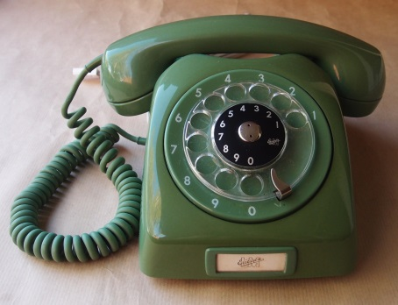

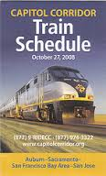
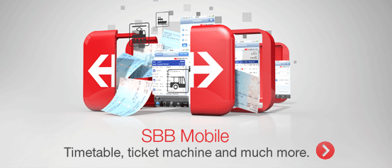
Statewide Rail Network:
Integration for 2040, 2050, 2060, 2070…
For all forms of rail - Integration means:
  Re-examining current approaches that restrict adaptation to future needs (economic, environmental)
  Creating policies and governance built upon system interdependence and function
  Using tools ranging from land use planning to technology to optimize mobility options for people
What are we getting done now that will create the “normal” our grandchildren will experience?

Slide 5
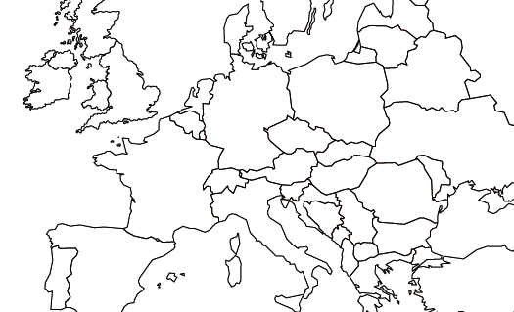
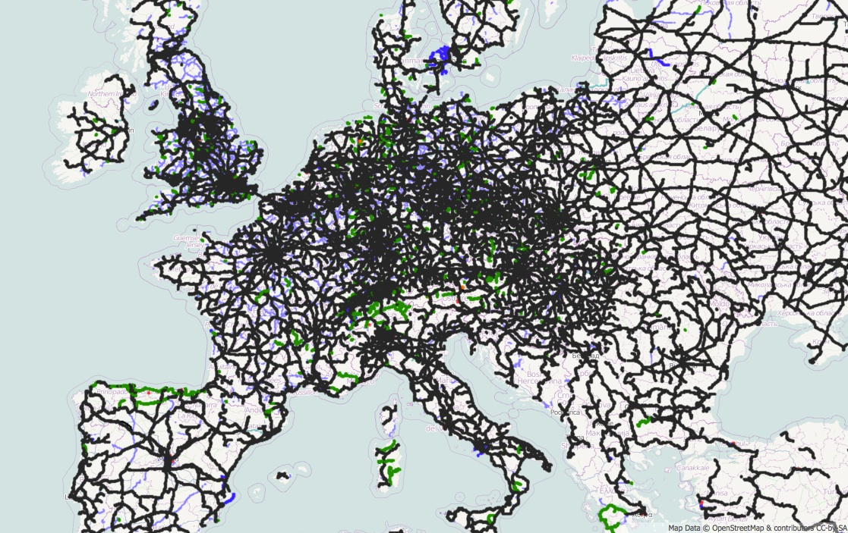
Service Integration: Rail Meshes with People’s Mobility Needs, Economies, and Environment
"European railway map" by PeterEastern (talk) using data from OpenStreetMap and contributors - slippy map version. Licensed under CC BY-SA 3.0 via Wikipedia - http://en.wikipedia.org/wiki/File:European_railway_map.jpg#/media/File:European_railway_map.jpg

Slide 6
California Rail: Private and Public
Red: Publicly owned
Black: Privately owned
Many lines (private and public) no longer exist as functioning railroads

Slide 7
The Intercity Gap in Public Ownership
Highspeed Rail:
  Phase 1 (Blue) & Phase 2 (Gold)
California’s rail ownership
  Inter-urban/urban transit systems
    Caltrain, BART, Metrolink
  Former industry service - now abandoned routes
Our BEST: Intercity ownership between Fullerton and San Diego

Slide 8
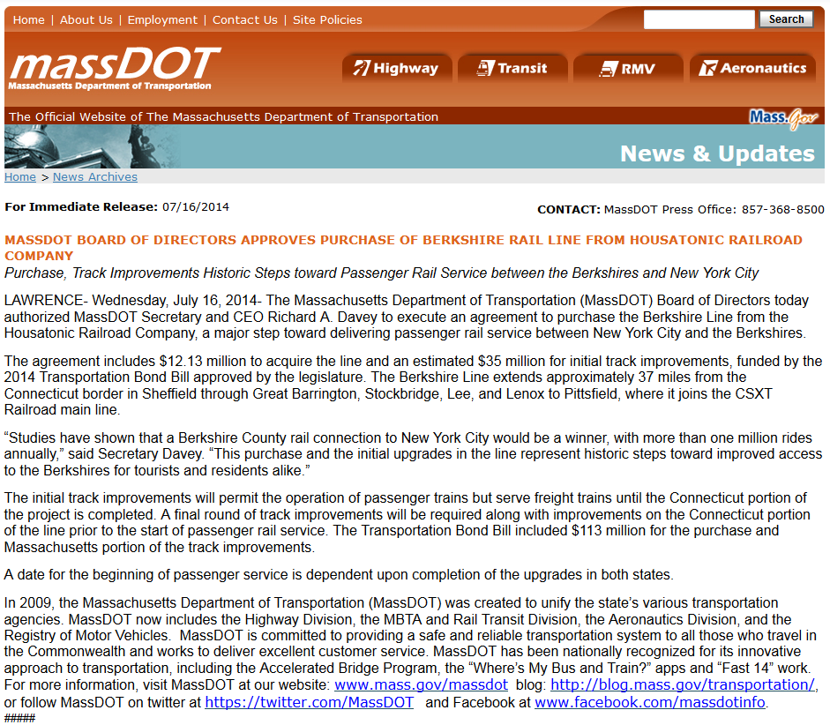

Slide 9
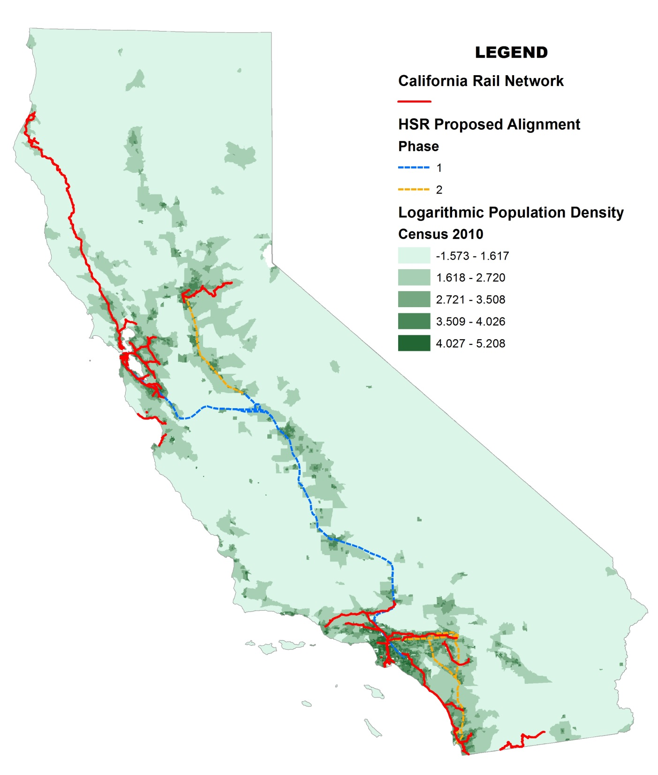
Ownership/Density Gap
2050 - 58% more people
Prop 116 bond legacy not equipped for 2050
Increasing urbanization/GHG redux/HSR require an adaptive CA Intercity Rail system
Control of ROW required to improve intercity frequency
Freight rail can’t be marginalized

Slide 10

Service Integration is:
Planning for Future Mobility Needs Now
Vision Plan Key Concepts
1-hour travel time between Sacramento and Oakland
Clockface frequency with 90 daily trains between Sacramento and San Jose
Minimize freight and passenger railroad interference
Increase railroad safety (grade separations, signal technology)
Initial Vision Plan Ridership Estimates
2015 Service | 2040 Baseline (2015 Service Levels) | 2040 Vision with Growth*
1,402,300 | 2,267,200 | 6,112,567
% increase above 2015 service | 62% | 336%
*Average ridership growth for several alignment alternatives considered in the Vision Plan Update (2014).

Slide 11
Mega-Region Mobility: Big Challenges – Crucial Opportunities
CCJPA Vision Plan: Key Focus Areas
Sacramento - Auburn
Roseville 3rd Track Project will expand current capacity to operate up to 10 roundtrip trains in this segment
Opens options to increase service levels to Auburn
Suisun/Fairfield - Sacramento
Reconstructed or new freight connections and routes are necessary to separate freight and passenger rail traffic
Richmond – Suisun/Fairfield
Route proximity to Bay presents existing storm surge and future sea level rise risks
Alternative speedier alignments include Franklin Canyon tunnels or straighter coastal route and a new high-level crossing
Oakland - Richmond
No alternative at-grade alignments available in this segment
ROW acquisition requires participation of multiple partners
Oakland
Changes to ROW in Jack London Square are critical
No inexpensive options for potential grade-separated alignments
San Jose – Oakland Coliseum
Wetland and sea level rise considerations
Several alternative alignment options exist with similar speed and capacity

Slide 12

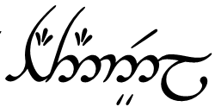
CCJPA’s Vision Plan Trilogy *
CCJPA Adopted
Commencing development
Commence when #2 is sufficiently along
1
2
3
Vision Plan
Update
Vision Communications
Plan
Vision Implementation
Plan
* Any future movie rights will be the property of CCJPA

