Slide 1
2015 Federal Rail Legislation
Karen Hedlund
Director, Public-Private Partnerships
Notes:
Having spent 4 years at the FRA, and much of that focused on delivering a new high performance rail system, I would like to spend a minute talking about what the Administration has accomplished to date, what its vision is for the future, and the opportunities and challenges for delivering projects in the pipeline – using alternative delivery mechanisms.
My perspective is that of the government sponsors and public owners.

Slide 2
Pending Federal Rail Legislation
Grow America
PRRIA of 2015
RIFIA
PTC Extensions
Other proposals

Slide 3
Grow America Act – “Predictable, dedicated funding for rail”
Rail account in Transportation Trust Fund – funded from corporate tax savings
$29 billion over 6 years
Two new programs:
Current Passenger Rail Service program -- Amtrak’s existing business lines
The Rail Service Improvement Program --new corridors and upgrades to existing corridors, rail relocations, grade crossings, and short line rail improvements, planning, workforce, and technology development, and commuter rail PTC-related costs.
Extend deadline for PTC on a case-by-case basis.
Regional Rail Development Authorities, eligible recipients of federal grants, to facilitate rail service improvements across state lines, including planning, corridor development, and financing activities.
Authorize funding to cover the cost of direct loans

Slide 4
USDOT Budget and Reauthorization Overview
FY 2016 Budget – $5.018 billion request
Safety & Operations – $203.8 million
Research & Development – $39.3 million
National High-Performance Rail System – $4.775 billion
GROW AMERICA Act
2014 Legislative Proposal
New Legislative Proposal
4 Years
(FY 2015 - FY 2018)
$302 billion total
$19 billion
National High-Performance Rail System
6 Years
(FY 2016 - FY 2021)
$478 billion total
$29 billion
National High-Performance Rail System
Provides Predictable, Dedicated Funding for Rail
Notes:
President’s budget for 2016 and 6-years transportation proposal continues this commmitement with $29 billion over 6 years for fund a national high-performance rail system.

Slide 5
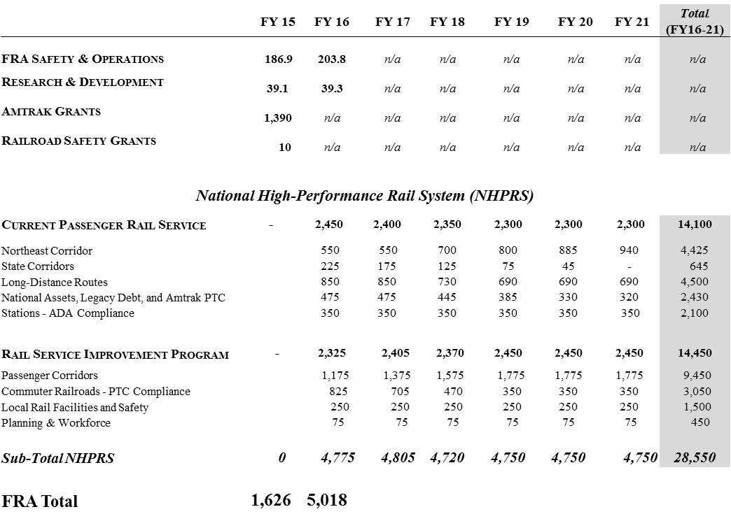
Funding Overview
General
Fund
Traditional FRA accounts
Transportation Trust Fund
(new Rail Account)
Current services (incl. Amtrak) organized by “business lines”
Integrated investments in growing &
improving rail
Notes:
This chart in your materials shows how it is allocated among safety, current rail service, primarily Amtrak, and rail service improvements including commuter railroads, PTC, local rail facilities and safety, including grade separations and planning and workforce.

Slide 6
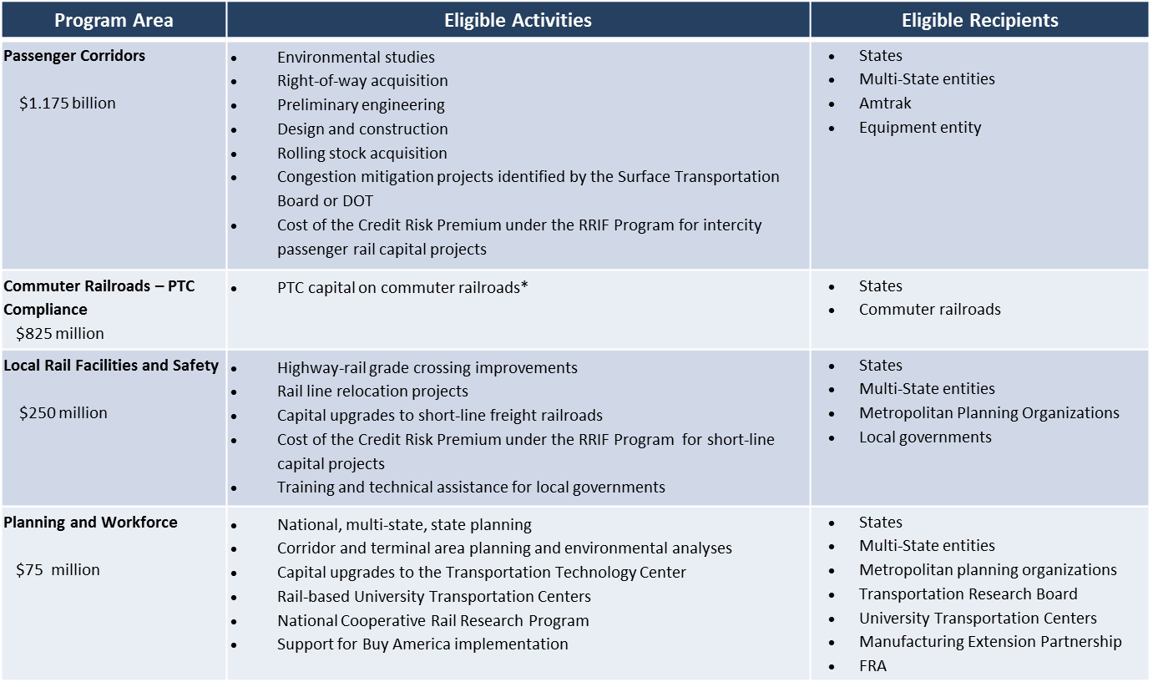
NHPRS: Rail Service Improvement Program (FY16 Request = $2.325 billion)

Slide 7
Passenger Rail Reform and Investment Act of 2015
Amtrak - Northeast Corridor v National Network
NEC $439 million in 2016
National Network account -- $973 million in 2016
National infrastructure investment capital grants - $300 million annual
State-Supported Route Advisory Committee.
State representatives.
To develop metrics for performance, and incentives and penalties.
Disputes got to STB
Revises Alternate Passenger Rail Service Pilot Program to permit transfer of up to 90 percent of the subsidy allocated to that route.
Directs Amtrak to request proposals from private sector to utilize Amtrak-owned rights-of-way for telecom systems, energy distribution systems.

Slide 8
PRRIA 2015 - continued
Amtrak to study options of development around RR stations, including multimodal connections and value capture
Amends RRIF to require consideration of future streams of payments in making creditworthiness decisions
RRIF to give priority for positive train control
$900 million RRIF loan for PTC nearing closing for Metro-North and Long Island Rail Road
RRIF procedural improvements and deadlines
Rulemaking for review, permitting and approval of rail infrastructure projects.

Slide 9
S. 797 (Booker) - Railroad Infrastructure Financing Improvement Act (RIFIA)
CRP to take into account rate covenants, ratings, coverage requirements
Maturity dates extended to lesser of 50 years or 90% of useful life
RRIF loans can finance TOD projects, subject to payment of “fee”
Real estate developer eligible borrower
Payment deferral until 5 years after project achieves substantial completion
CRP can be paid from “other federal funds”
Authorizes appropriations for CRP - $100,000 annually
Master Credit Agreements for “program of projects”

Slide 10
Senate PTC Extension Bills
Railroad Safety and Positive Train Control Extension Act (S. 650), approved by the Senate Commerce in March, extends the deadline from the end of 2015 to Dec. 31, 2020.
Feinstein-Blumenthal-Schumer – one year extensions on a case by case basis
PPRIA 2015
Grow America – case by case
$3 billion over 5 years for PTC

Slide 11
Contact
Karen J Hedlund
Director, Public-Private Partnerships
Parsons Brinckerhoff
212 465 5059
hedlundk@pbworld.com

