Slide 1
Caltrain Modernization Program
CA Passenger Rail Summit
April 29, 2015

Slide 2
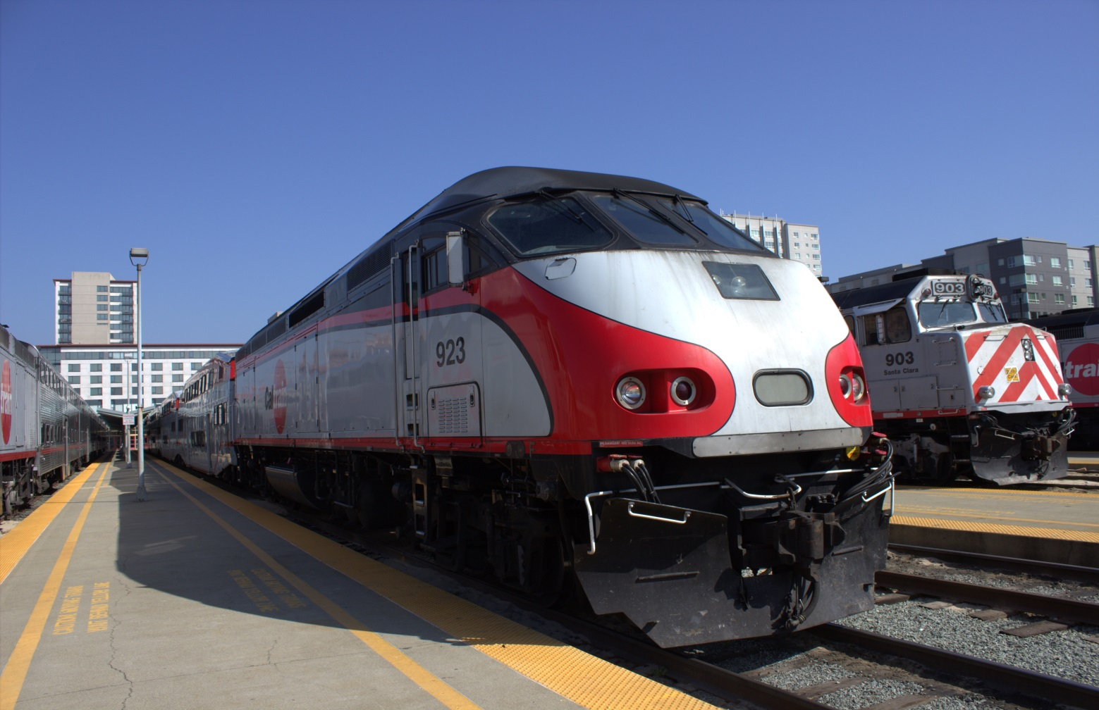
Caltrain System Today

Slide 3
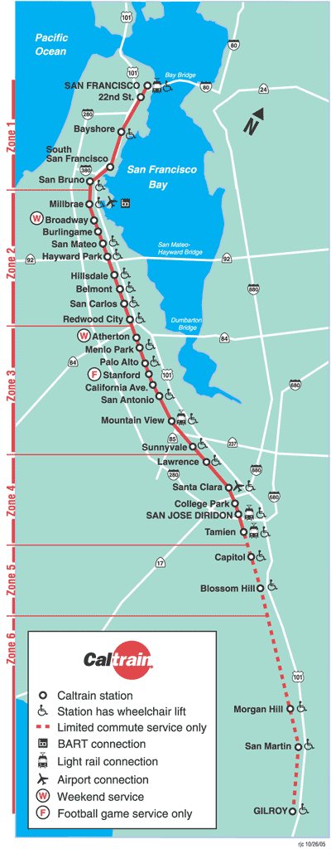
About Caltrain
Diesel commuter rail system
SF to SJ area
77 mile corridor, 32 stations
Ridership Today: ~ 61,000+ weekday
Projected 2040 Ridership: ~100,000+ weekday
Tenants: ACE, CC, Amtrak, freight

Slide 4
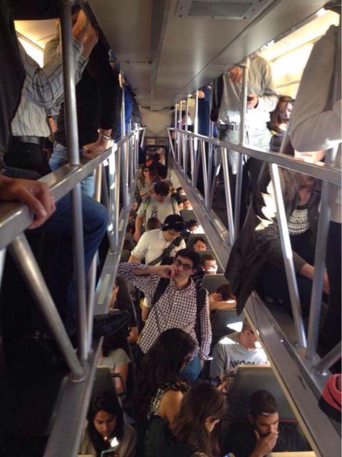
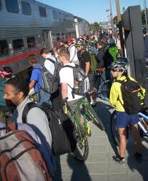
Over Capacity
Northbound
Train # | Depart SJ | Max Load | % Seated Capacity
319 | 7:03am | 796 | 123%
323 | 7:45am | 746 | 115%
329 | 8:03am | 738 | 114%
375 | 5:23 | 689 | 106%
217 | 6:57am | 675 | 104%
225 | 7:50am | 674 | 104%
233 | 8:40am | 641 | 99%
313 | 6:45am | 632 | 97%
Southbound
Train # | Depart SF | Max Load | % Seated Capacity
376 | 5:33pm | 813 | 125%
370 | 5:15pm | 706 | 109%
366 | 4:33pm | 690 | 106%
268 | 4:56pm | 670 | 103%
278 | 5:56pm | 648 | 100%
324 | 8:14am | 622 | 96%
322 | 7:57am | 622 | 96%
Note: February 2014 counts (lower ridership season)

Slide 5
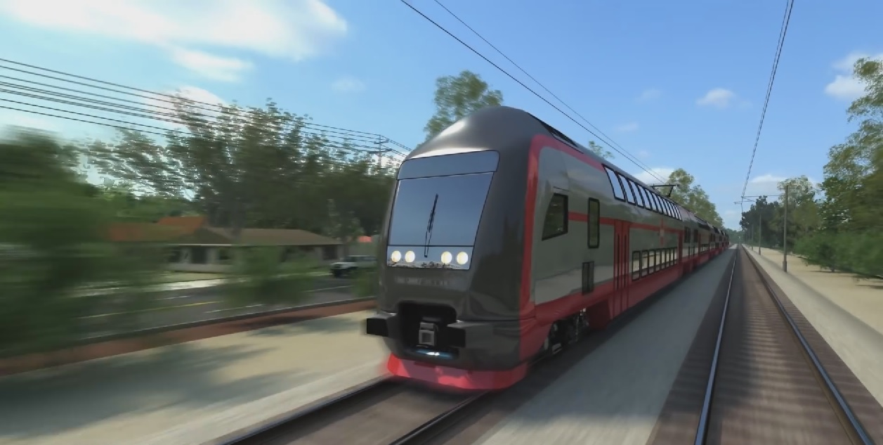
Caltrain Modernization

Slide 6
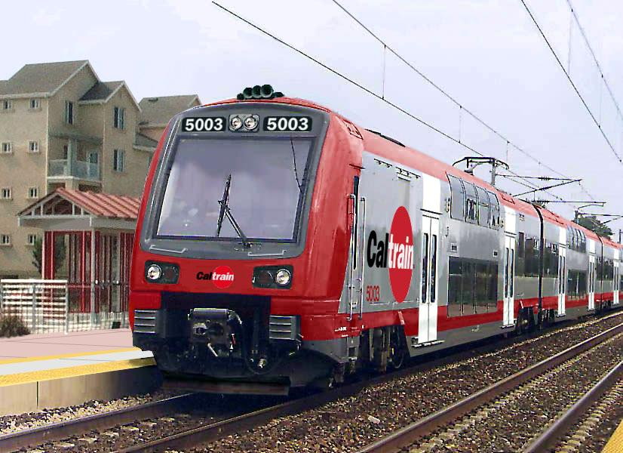
Caltrain Modernization Program
Early Investment Program
Advanced Signal System: CBOSS PTC (2015)
Peninsula Corridor Electrification Project (2020)
Caltrain/HSR Blended System

Slide 7
Peninsula Corridor Electrification Program
Area | Project | Service
51+ miles San Francisco to San Jose (Tamien Station) | Electrification: Overhead Contact System (OCS) Traction Power Facilities Electric Multiple Units (EMUs) | Up to 79 mph Service Increase 6 trains / hour / direction More station stops / reduced travel time Restore Atherton & Broadway service Mixed-fleet service (interim period) Cont. tenant service

Slide 8
Key Regional Benefits (2040)
Note: 2013 BAC Report, generates $2.5B economic activity and 9,600 jobs

Slide 9
Key PCEP Milestones
2008 35% Design
2009 FONSI
2012 9-Party Regional Funding Plan
2013 DB Contracting Method Selected
2014
RFQ and RFI complete
2015
EIR Certification
Update Funding Plan (cost update)
Issue RFPs
2016-2020 Design/Manufacture/Build/Test

Slide 10
Rail Integration

Slide 11
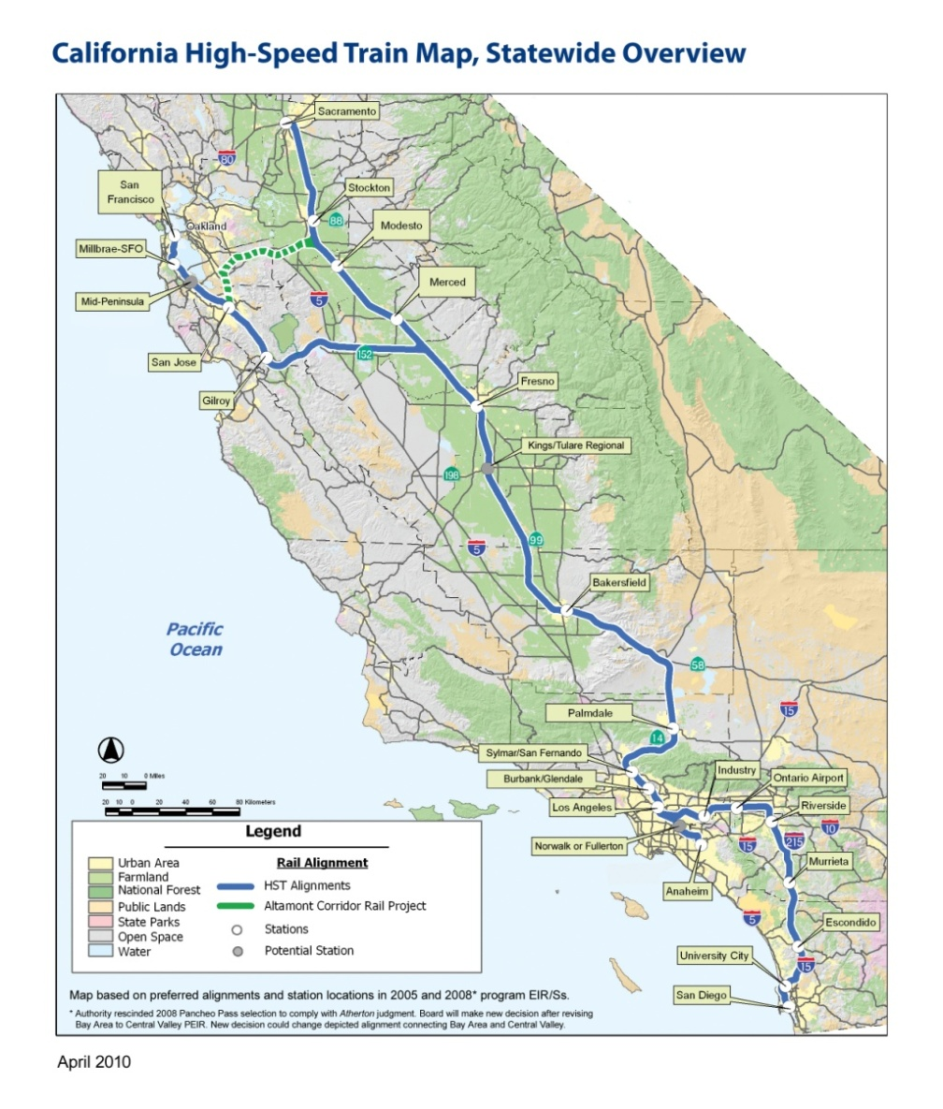
HSR / Caltrain Blended System
Notes:
11

Slide 12
Future Incremental Investments
Additional Caltrain Improvements
Longer Trains / Platforms
Level Boarding
Additional HSR Improvements
HSR Stations
Passing Tracks
Maintenance Facility
System Upgrades (110mph)
SF Downtown Extension
(led by TJPA)
CalMod Program
CBOSS PTC 2015
Corridor Electrification 2020
State of Good Repair & Reliability / Capacity Improvements
Green – Caltrain lead; Orange– partner agency lead

Slide 13
Shared System (Tracks)
Sensitivity to community footprint
Share existing 2 track system (primarily)
From 79 mph to 110 mph
10 slots peak hour one way
6 for Caltrain
4 for HSR (with passing tracks)
Trade-off (for community buy in)
Limit capacity (long term growth)
Limit flexibility / reliability

Slide 14
Shared System (Stations)
Dedicated or Shared Platforms
System Flexibility
Caltrain EMU Modification
Double sets of doors
One set of doors with traps
Trade-off (for system flexibility)
Seat loss
Operational challenges
Station footprints TBD

Slide 15
Food for Thought
Sharing / Integration
Is good
Prudent approach
Maximize utility
Trade-offs

Slide 16
Questions
For more information and project updates
website: www.caltrain.com/calmod
email: calmod@caltrain.com

