Slide 1
Station Development Update
Melissa DuMond,
Director of Planning and Integration
April 29, 2015

Slide 2
HIGH-SPEED RAIL: More Than A Transportation Program
California is 8th Largest Economy in the World
Comparable to Northeast Corridor in Terms of Distance, Population and Complexity
Transformative Investment
Connecting all California Population Centers
Notes:
HSR is a transformative investment that we should leverage to maximize change.
The equivalent capacity from San Francisco to Los Angeles would cost $158B in new highway lanes, additional airport gates and new runway terminals.

Slide 3
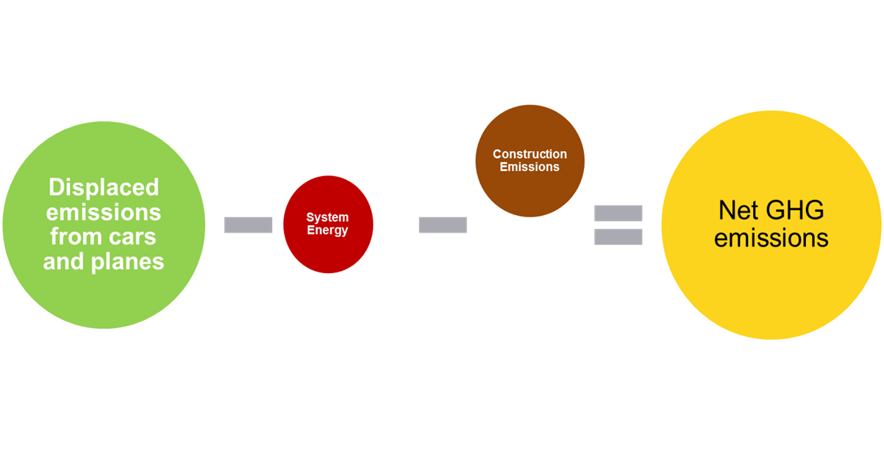
Environmental Benefits: High-Speed Rail’s Best Kept Secrets
Preserving Agricultural Land
Improving Air Quality
Preserving and Enhancing Critical Habitat
Reducing Greenhouse Gases
Enabling Smart Land Use
Urban Greening: Planting Trees
Modernizing Transit Statewide
100% Renewable Energy
Notes:
HSR has proven effective in dramatic mode shifts and actual reductions in higher polluting vehicles such as planes and cars.
As I mentioned by reducing impacts from additional highway lanes and other infrastructure, the capacity of the system helps to preserve agriculture land and critical habitat.
By focusing sustainable development around stations in cities, we can enable smart land use.

Slide 4
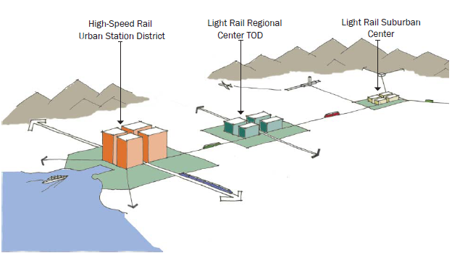
Rail integration for Sustainable California
High-Speed Rail the Key Element in a Statewide Clean, Electric Interconnected Rail Transportation System
Notes:
Rail integration for sustainable California is about better service to the user as investments are made in the CA passenger rail system, with HSR as the backbone to rail modernization and leveraging the opportunities that a major new transportation system in the state of California brings us to accomplish ghg reduction goals, sustainable development and growth in our economy.

Slide 5
Station Area Partnerships
Enhancing Communities
Notes:
Much of our job is connecting to and building upon the good work done by our partners by working with station cities on station area planning for infill and redevelopment, rail partners (all of you), enhancing connectivity and improving the overall state rail network, and working with our sister agencies focusing resources and our efforts to enhance the communities.
Our role is the development of a symbiotic relationship between HSR and the places it will serve.

Slide 6
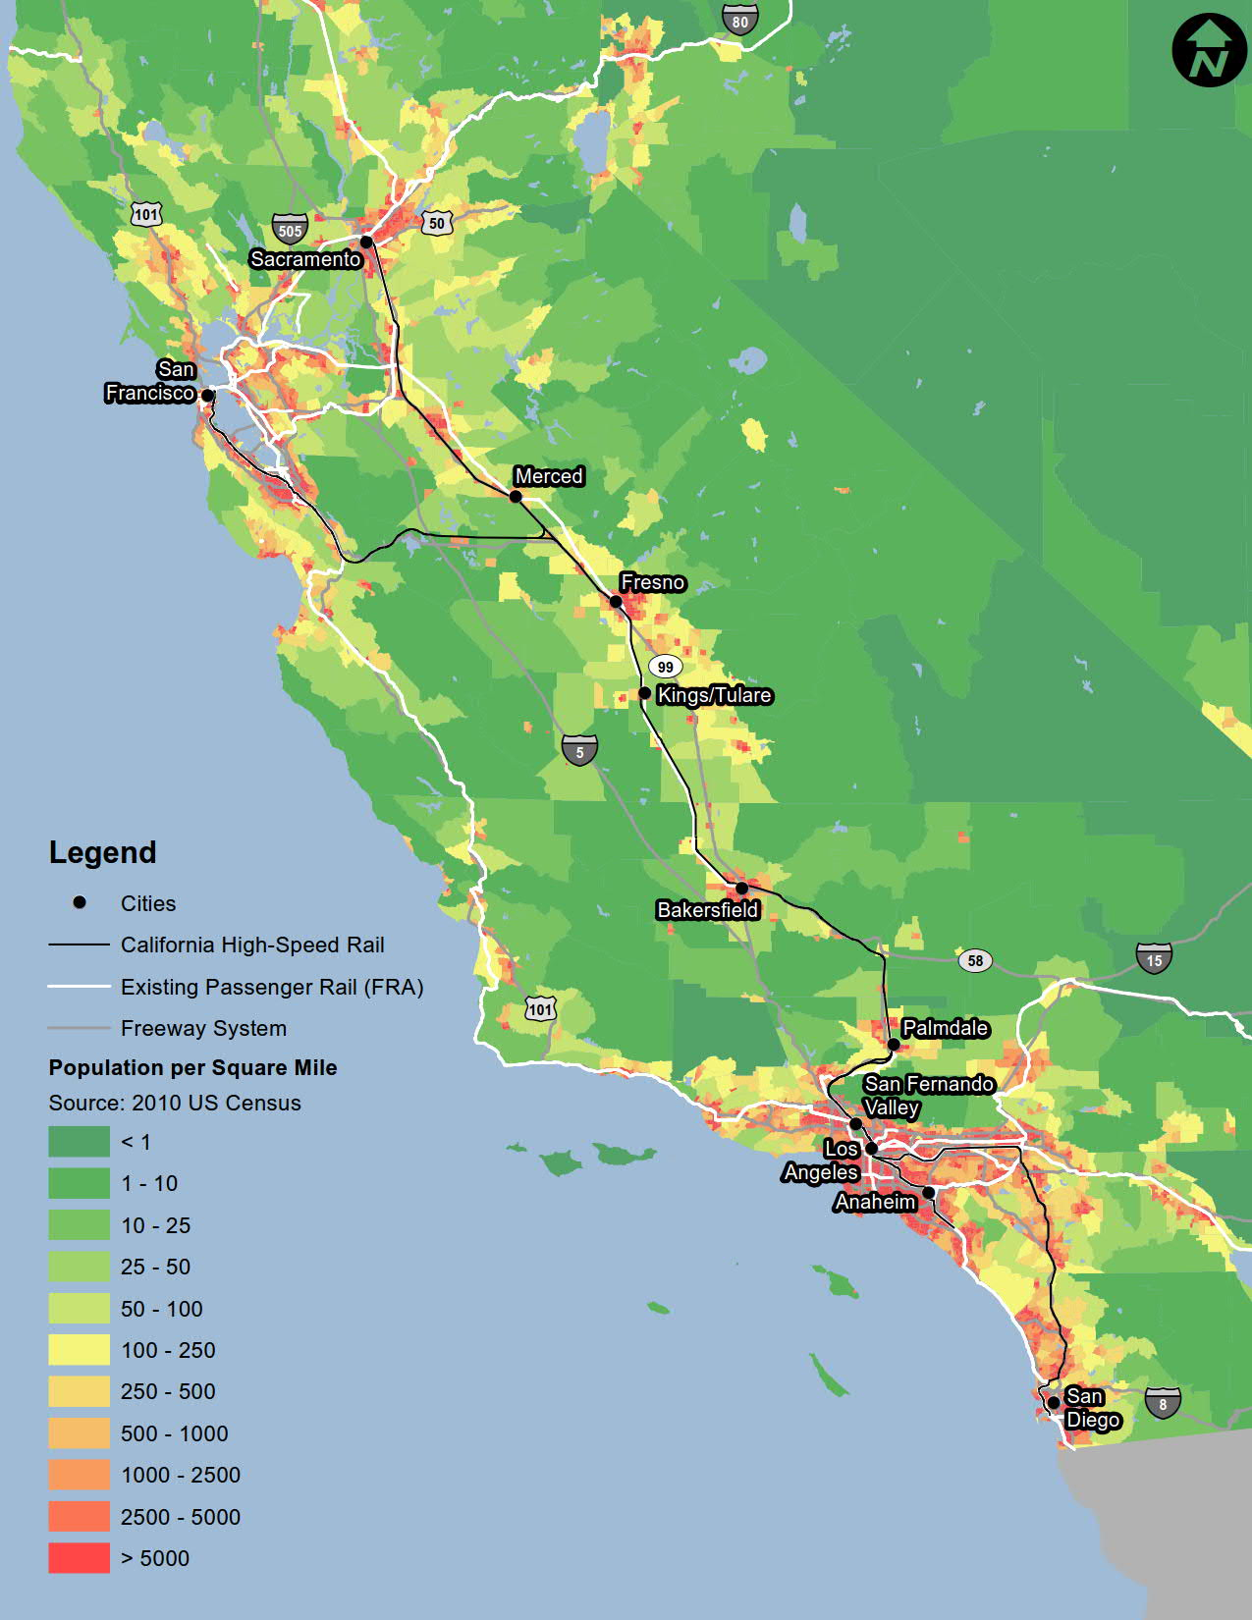
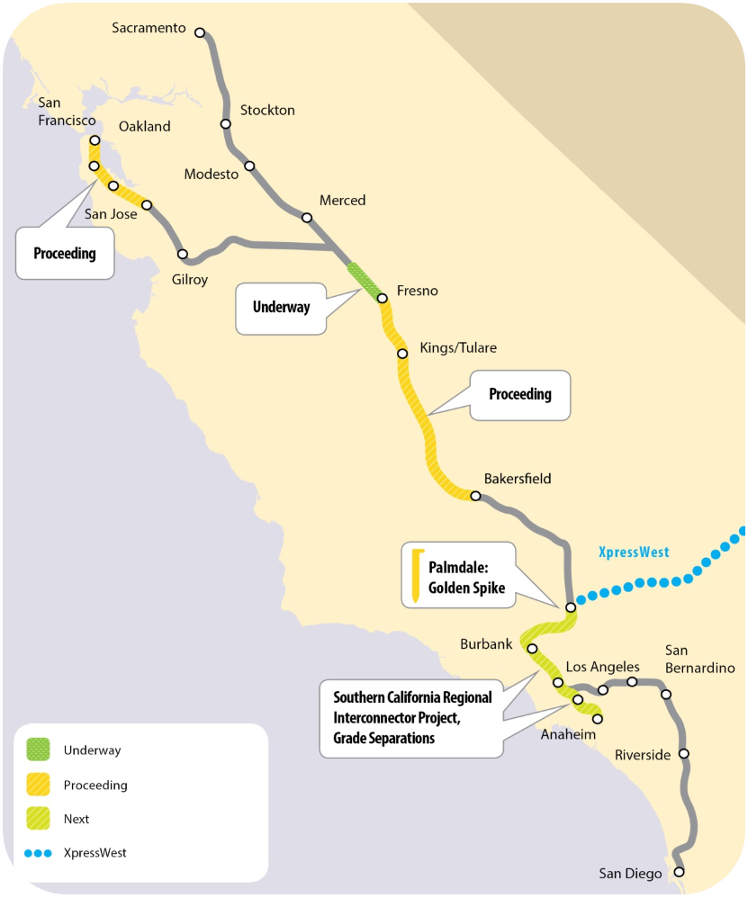
Where are the Stations ?
Up to 24 Stations
San Diego to Bay Area
Urban Centers Linked
Smaller Cities Served
Shared Transit Sites
Notes:
Where are the stations? They are in the heart of our populations, as you can see by the heat map on the left side of the screen.
The system includes up to 24 stations linking urban centers as well as smaller cities and enhancing multi-modal connectivity.

Slide 7
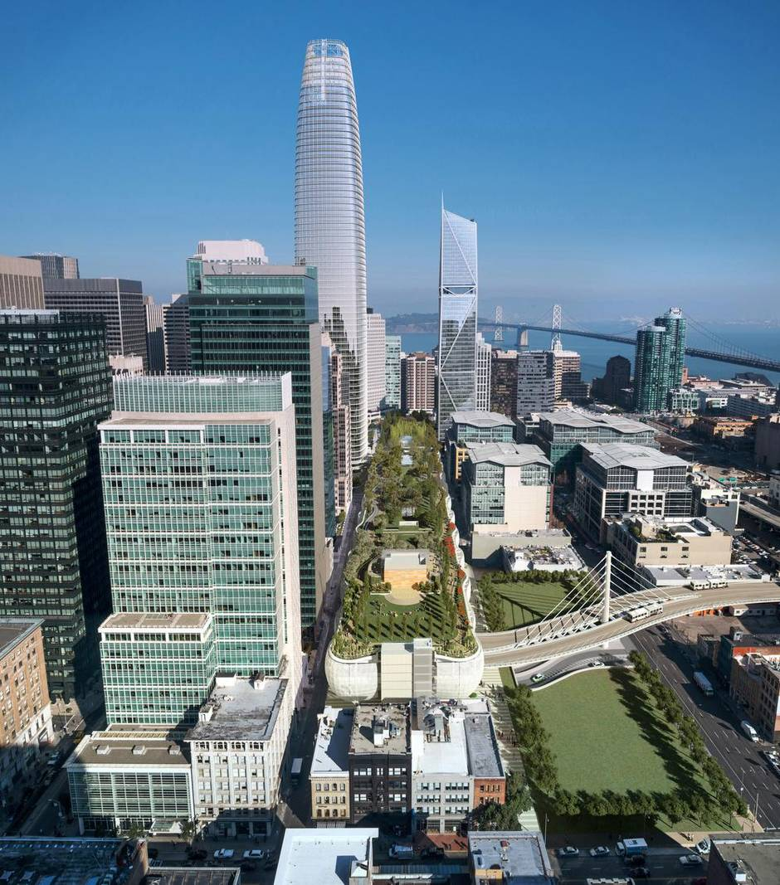
HSR Station Vision
Advance the economic role of stations
Statewide connectivity
Capacity for growth
Influence the heart of California’s cities
Integrate station design and station area planning
Expand connectivity & access
Create Value
Attract the next generation of travelers
Facilitate transit & sustainable infrastructure investment
Catalyst for private investment & joint development
Notes:
The HSR station vision is really about creating value in communities.
The station development will be integrated with land use planning, focusing on connectivity, smart growth and catalyzing private investments in station cities.

Slide 8
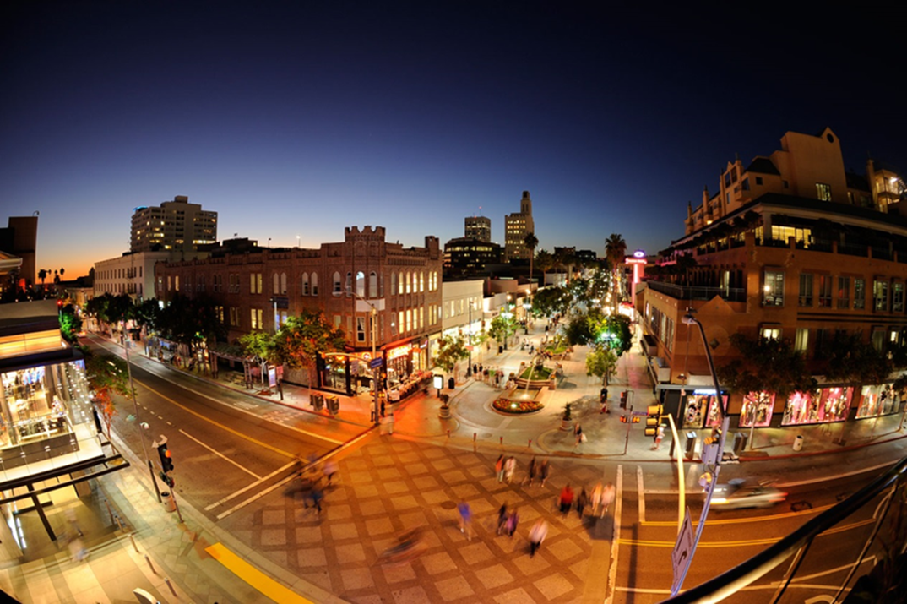
HSR Station Opportunities
Vibrant destinations
Attracts people, activity and investment
Point of entry to explore California
Infrastructure of global cities
Foundation for efficient, clean energy transportation
Capacity for future growth
Catalyst for transformational change
Enable HSR transit-oriented development
Notes:
Our joint goal with our station cities are to create vibrant destinations.
We want to enable HSR oriented development in the regions.

Slide 9
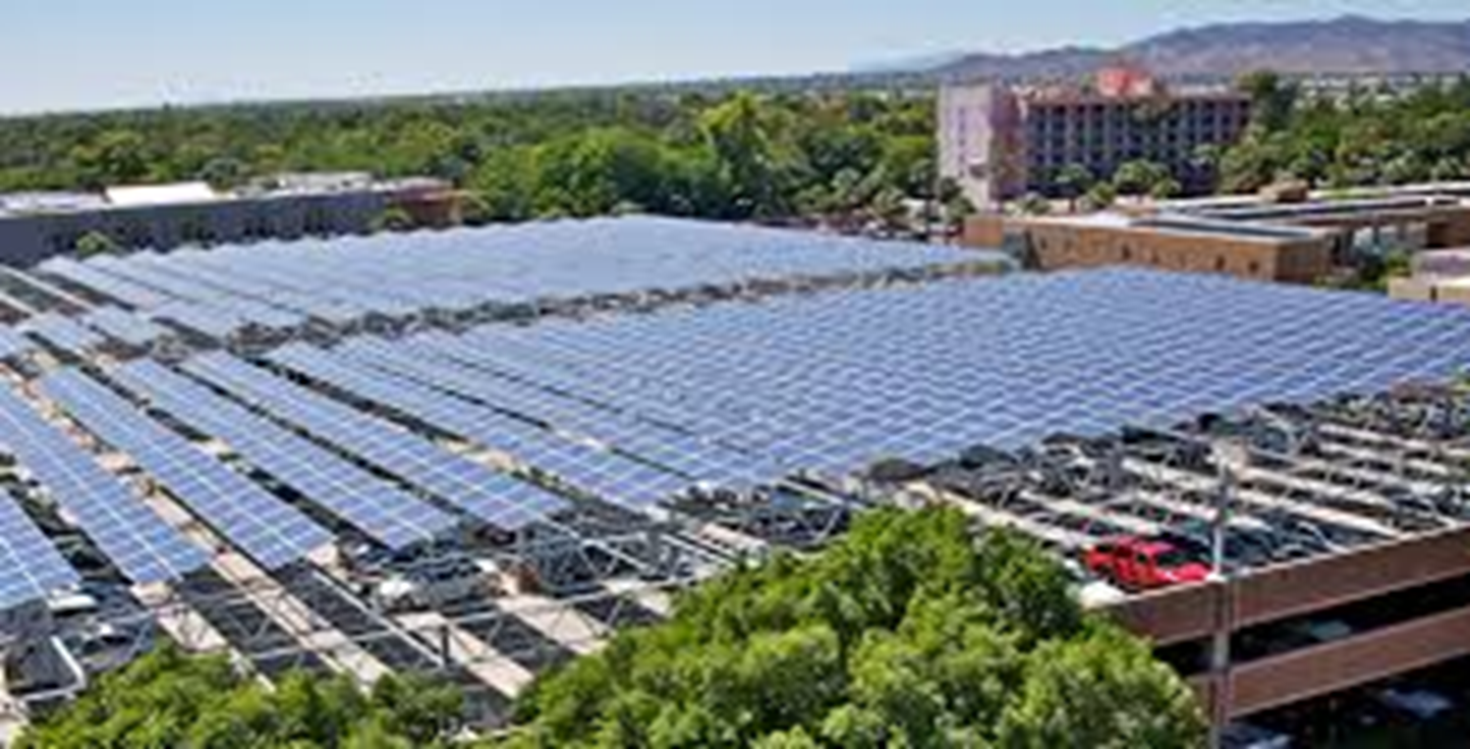
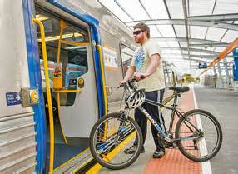
Top priorities for next year
Station Area Partnerships
Tool kit for station development
Statewide resource planning
Station Design
Multimodal access, passenger circulation and parking
Station progression planning
Sustainable design
Notes:
The model we’re developing for HSR stations is not unlike how this audience works together. We’re assessing station cities and the regions to understand the current conditions of diversity, density of development, community health, economics, access, connectivity, and land uses.
Understanding the future conditions we’re trying to achieve, we want to tap into each others programs and jointly pursue funding and implementation opportunities.
We’re envisioning our stations progressing over time as ridership increases with system build out and development increases.

Slide 10
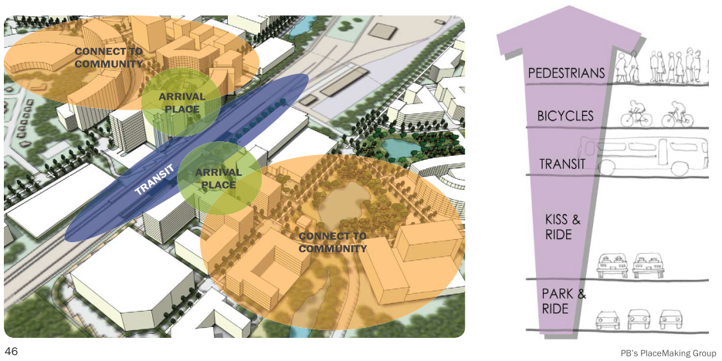
Station Design
Notes:
This slide illustrates the importance and prioritization of connectivity of the station to the community.

Slide 11
STATION PROGRESSION
Ridership
Time
Initial Service
Inter-Regional Service
Statewide Service
Cleared Environmental Footprint
Expanded Station
Full-Build out
Intermodal Station
EIS/ROD/EIR certification
Mitigation monitoring
Platforms, canopy & Infrastructure to support build-out
Surface parking
Place-making
Value capture program
Business & commercial services
Operations/facilities/access improvements
Structured/managed parking
Station as destination
Joint development & replacement parking
Realize long term land value
Notes:
We are looking at how a station will progress over time as ridership increases with system build out.
This model values place-making right from the start and the station as a destination over time realizing long-term land value.

Slide 12
Station Progression – evolution over time
Notes:
This is a schematic that assumes a gridded street pattern and land availability or a focus on infill development that we don’t have at all stations; however, it’s a visual depiction that’s helpful to understand the value of land acquisition around the station, public space, good access and flow of foot traffic- connecting with the existing community on opening day.

Slide 13
Station progression – Capacity improvements
Notes:
Here the station expands with new services and traveler amenities, expanded intermodal access, streetscape improvements around the station…

Slide 14
Station progression - infill
Notes:
Here is the station as a destination with expanded retail and commercial services, mix of land uses, land acquired earlier is optimized (reused) for its highest and best use.

Slide 15
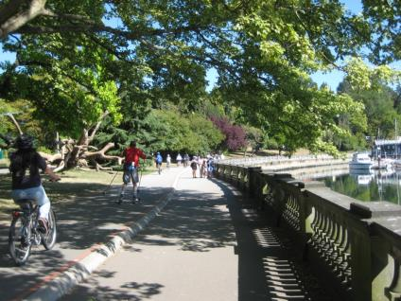
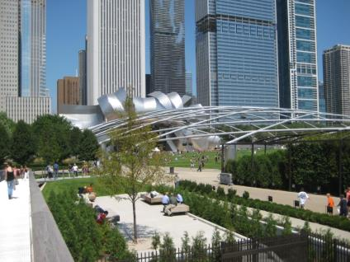
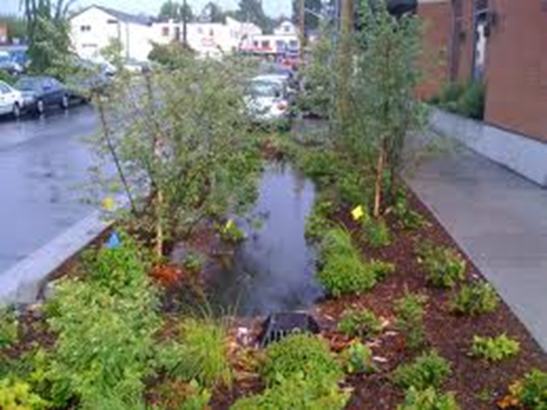
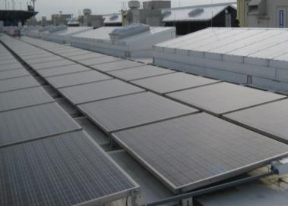
District Scale opportunities
Accelerating sustainable development, by integrating building and infrastructure
District energy, green streets, smart grids, demand management and resource sharing
Notes:
HSR stations are fairly significant investments in most of the station cities. The combination of infrastructure work and evolving development means it is the optimal time to explore district-scale activities in these cities.
It’s a unique opportunity to be more energy efficient and contentious than any standard building or development practice.
Clockwise from left: Chicago’s Millenium Park, new civic space over parking garage; Vancouver ; New York City, roof-mounted solar panels.

Slide 16
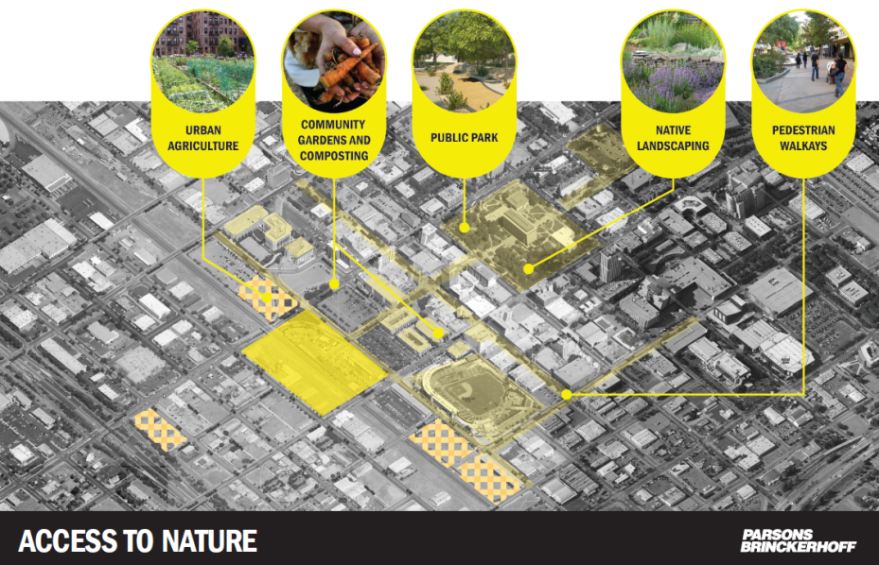
District Approach: Creates Livable Spaces
Notes:
The stations have the potential to incentivize development, and we want to explore with cities how the station site can provide livable community amenities that help attract new investors and provide lower costs to other investors hesitant about weaker markets.

Slide 17
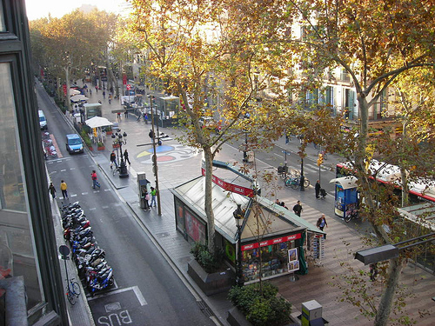
Thank you
Questions
California High-Speed Rail Authority
770 L Street, Suite 800
Sacramento, CA 95814
(916) 324-1541
info@hsr.ca.gov

