Slide 1
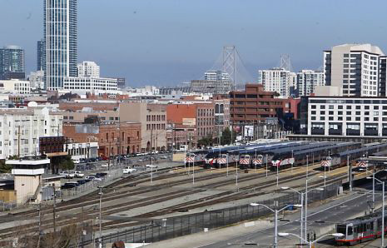
FUNDING CALIFORNIA’s PASSENGER RAIL SERVICES
Sharon Greene
HDR / Sharon Greene + Associates
April 2015

Slide 2
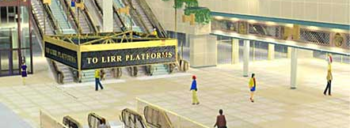
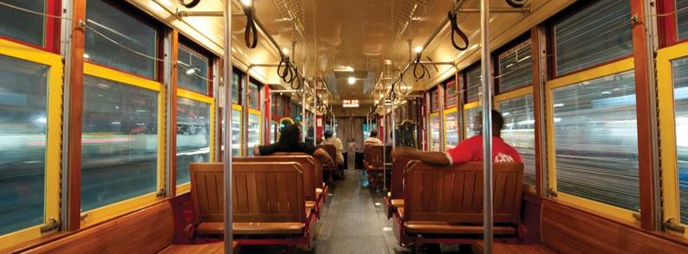
Overview of presentation
Background
  California’s Passenger Rail Services
Funding Issues and Trends
Addressing Funding and Financing for Capital, O&M, and Asset Management

Slide 3
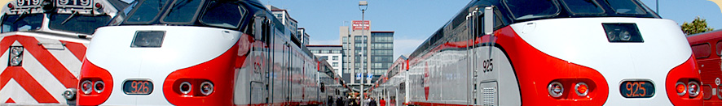

California’s passenger rail services
California High Speed Rail
Existing Intercity Passenger Rail Services
  Managing Agencies for Capitol, Pacific Surfliner, and San Joaquin Corridor services
Existing Commuter Rail Services
  Joint Powers Authorities for Coaster, Metrolink, ACE, Caltrain, SMART
Intercity and Commuter Rail Service Extensions and New Services
  MPO and Local Agency Champions
    Coachella Valley, Ventura/Santa Barbara, San Luis Obispo,

Slide 4
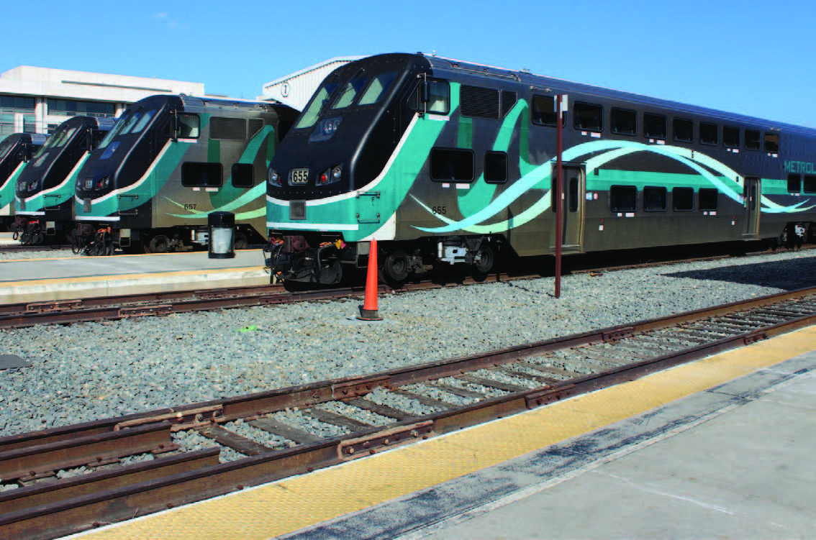
Related considerations
Changing role of California State Transportation Agency (CalSTA) relative to Corridor Managing Agencies
  Challenging to achieve Statewide perspective / priorities for capital funding
Changing role of CalSTA in capital funding decisions
  Cap and Trade/Greenhouse Gas Reduction Fund project selection

Slide 5
Related considerations
Overlapping membership in Intercity Rail JPAs and Commuter Rail JPAs
  Favors capital funding of projects that benefit multiple existing services: CR, IC, and HSR
Operating funds capped and allocated to the existing Intercity CMAs
New service / extensions compete with existing services for funding

Slide 6
On-going financial support for passenger rail services throughout PROJECT Lifecycle

Slide 7
FUNDING RELATED ISSUES
Funding Picture for Operations and Maintenance, Capital, and State of Good Repair
  Federal: Reauthorization of MAP-21
  State issues
  Regional and Local issues
Search for Sustainable Funding
  Capital
  O&M
  SOGR
Opportunities for Innovative Funding, Financing and Public Private Partnerships

Slide 8
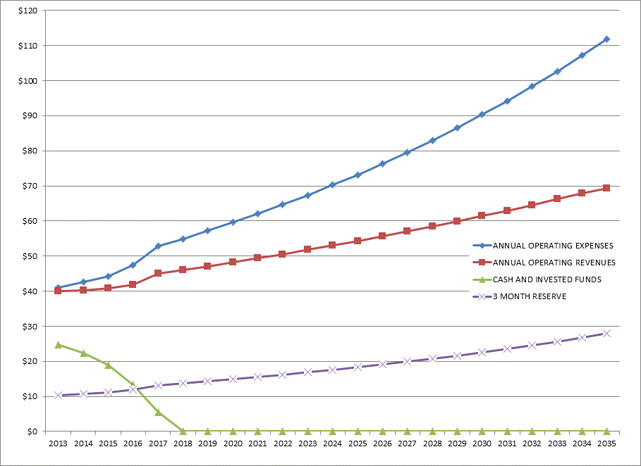
O&M issues: cost sharing and Differential Rates of Growth in Costs and Revenues
High rates of cost growth, in particular
  Labor
  Benefits (Pensions, Health)
  Other 30%: Fuel, Maintenance, Utilities
Growing SOGR backlog
Costs shared among member agencies with different priorities
Competing priorities facing IC and CR member agencies

Slide 9
Capital needs and State of Good Repair
Unfunded federal mandates including PTC
Vehicle replacement and locomotive modernization
Electrification
Station, parking, and facility upgrade and expansion
Development of major hub stations
Growing competition for funding
  Intercity and Commuter Rail needs compete with Urban Rail / Streetcar / BRT at the federal and State level
  And with other Bus and Paratransit needs at the local and regional level

Slide 10
Impact of Reauthorization / MAP 21
Historical underfunding of HSR and Intercity Passenger Rail
  No dedicated source of funding for intercity passenger rail
Federal transportation funding authorization ends May 31st
Mass Transit Account, like Highway Trust Fund, going bankrupt in 2015
  No political will to increase motor fuels taxes to replenish MTA and HTF
  Trust funds and annual appropriations dependent on Congressionally-approved transfers from the General Fund
  Funding and financing problems due to lack of multi-year funding commitment

Slide 11
Impact of Reauthorization / MAP 21 (2)
Elimination of most Discretionary grant programs
  Only FTA New Starts/Small Starts, Low/Zero Emission Vehicles remain
  TIGER grant program – annual renewal
Broader range of eligible projects for the few competitive grant programs remaining
Reduced funding from Formula based programs

Slide 12
Impact of Reauthorization / MAP 21 (3)
Increased reliance on Financing as opposed to funding
  TIFIA Program
  RRIF Program
Increased interest in potential role of Public Private Partnerships

Slide 13
State funding opportunities and Issues
California’s Cap and Trade Program
  Creation of Greenhouse Gas Emissions Reduction Fund
  Dedicated funding for California High Speed Rail
  Transit and Intercity Rail Capital Program (TIRCP) competitive grants
Reduction in other State funding due to reduced revenues
  New revenue measures introduced for gas tax, vehicle registration fees, other
Notes:
I thought you would find the attached article from the Legislative Analyst’s Office of interest with regard to our discussion of the 2010 / 2011 Gas Tax Swap. As you thought, there were 2 propositions passed by the voters (Prop 22 and Prop 26). However, these propositions were passed to a) restrict the State’s ability to make the swap unless approved by a 2/3rds vote of the Legislature and 2) restrict the State’s ability to use gas tax revenues for repayment of highway debt service.
To get around these propositions, in 2011 the Legislature approved the Governor’s budget provision by a 2/3rd vote, thereby allowing the swap. To get around the restriction on use of gas tax revenues for repayment of debt service, Caltrans did another “swap” by depositing the gas tax revenues into the State Highway Account and using truck weight fees already in the SHA for repayment of the debt service.
There was also a provision to reduce the gas tax on diesel and increase the sales tax on diesel to provide some funds for transit. In terms of who was made whole by all of this, the greater benefit was to relieve the General Fund to provide funding for the highway program.

Slide 14
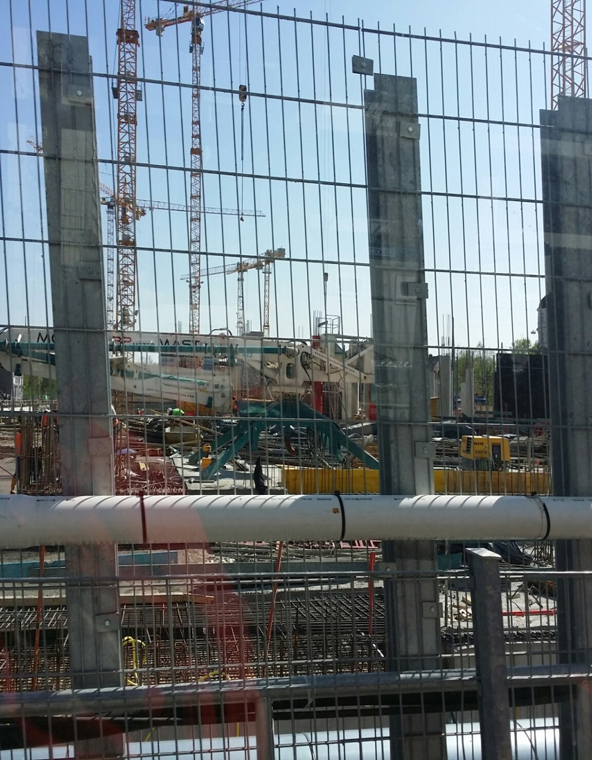
Local funding opportunities and issues
Increased reliance on regional and local funding
  Success of county sales tax measures
  Dedicated commuter rail funding
Increased interest in value capture-based approaches
  Station area development
  Major multimodal centers
  Redevelopment and tax-increment finance restricted

Slide 15
Capital Funding of new Commuter Rail services
 | Sun Rail (FL) | North Star (MN) | Front Runner North (UT) | Front Runner South (UT) | Music City Star (TN) | A-Train (TX) | MetroRail (TX) | Rail Runner (NM) | Sounder (WA)
Federal
New Starts | $179 | $157 | $489 |  | $24 |  |  |  | $100
FHWA Funds |  | $5 |  |  | $8
State | $89 | $99 |  |  | $4 |  |  | $125
Local Jurisdictions | $89 | $51 |  |  | $3 |  |  | $10
Dedicated Sales Tax |  |  | $82 | $368 |  | $48 | $105 |  | $301
MPO Programmed Funds |  | $6 |  |  | $2
Right-of-Way Value |  |  | $40
Toll Road Concessionaire Payment |  |  |  |  |  | $190
Total | $357 | $317 | $612 | $368 | $41 | $238 | $105 | $135 | $401
Notes:
Table summarizes the capital funding strategies used to implement 9 of the most recent commuter rail lines. As shown in the table , 5 of these projects were successful in obtaining FTA New Stars funds. The share of New Starts funding ranged from 25% to 80%, however it should be noted in today’s current federal funding climate, a project the size of the FrontRunner North would no longer receive 80% funding from New Starts. FTA is encouraging project sponsors to limit requests to 50%.
Two projects did use Federal Highway Administration funds (congestion mitigation and air quality improvement (CMAQ) and/or Surface Transportation Program (STP) funds.
State funding was key for three projects include the Sun Rail Project in Orlando where FDOT is providing funding for 25% of the total project costs.
The largest local funding sources were dedicated sales taxes and direct contributions from the local jurisdictions (counties and cities served by the line).
In Denton County (TX), the A-Train, funding for this project included local dedicated sales tax revenue and an allocation of $190 m to the transit agency from the payment received from a concessionaire’s agreement to enter into a long term lease for a regional toll road.

Slide 16
Key federal Capital Sources
Federal: can’t exceed 80% of total project costs
Federal Transit Administration
  FTA New Starts / Small Starts / Core Capacity
    FTA New Starts
      Project Costs > $250 M
      Can provide 50% of total funding
  FTA Small Starts
    Project Costs < $250 M
    $75 M maximum

Slide 17
Key federal Capital Sources
Federal Railroad Administration (FRA)
  Including 2014 grant opportunity for previously unallocated grant funds
  (Go Coachella Valley! $2.98 million!)
Federal Highway Administration (FHWA) Flexible Funds
  Congestion Mitigation and Air Quality (CMAQ)
  Surface Transportation Program (STP)
  Transportation Alternatives (TA)
US DOT TIGER Grants
Other Federal (non-transportation sources)
  Department of Commerce: Economic Development Agency
  Housing and Urban Development (HUD)
  Environmental Protection Agency (EPA)
  Department of Defense (DOD)

Slide 18
Key state Capital Sources
State
  Proposition 1A High Speed Rail and Connectivity bond proceeds
  Proposition 1B limited balances (PTMISEA, eg)
  Regional Transportation Improvement Program
  Interregional Transportation Improvement Program
  Greenhouse Gas Emissions Reduction Fund: TIRCP
  SB 862 Affordable Housing and Sustainable Communities (AHSC) Program

Slide 19
Key regional and local Capital Sources
Local and Regional
  Existing and future voter-approved local dedicated funding
  Benefit Assessment Districts
  Enhanced Infrastructure Financing Districts (replaces TIF)
  Property / ROW donations
  Naming rights
  Cost sharing with major activity centers / employment centers, universities, other institutions served
  Lease revenues
  Access/usage fees

Slide 20
Key O&M Funding Sources
Fares / fare subsidies
  Distance-based fares
  Fare / fare pass cost increases
CMAQ (first 3-years of operations)
Reallocation of existing fixed route bus service
Cost sharing with major activity centers / employment centers, universities, other institutions served
General fund
Advertising / Naming rights
Parking revenues
Transient occupancy tax
Admission fees

Slide 21
Key O&M Funding Sources
Contributions from local jurisdictions
  Split equally among all jurisdictions
  Potential cost allocation methodology with variables that could include:
    System-wide elements: divided equally among jurisdictions serviced
    Jurisdiction specific costs: based on route miles of track and number of stations located with each jurisdiction
Notes:
If capital funding were to be provided from the local jurisdictions, there are two potential approaches to dividing the costs:
Split all capital costs equally among the jurisdictions being served
Develop a cost allocation methodology that allocated costs based on specified variables
Systemwide costs (vehicles, maintenance facility, signals and systems) could be split equally among all jurisdictions
Jurisdiction specific costs (track, stations, other localized improvements) would be based on the number of route miles of track and number of station within each jurisdiction.
This approach would require negations and policy decisions among the jurisdictions being served by the line.

Slide 22
Federal Financing Tools: TIFIA & RRIF
TIFIA loans can have more flexible repayment terms, with lower interest rates:
  Funds 1/3 of project at US Treasury rates
  Program capacity ($1 B/year)
  Increasing competition among modes and mega-to-small projects
RRIF has over $30 B for lending:
  Greater project coverage
  Program capacity
  Higher cost, with project sponsor paying risk premium
  Length of application process
Project Cashflow with TIFIA Loan Example

Slide 23
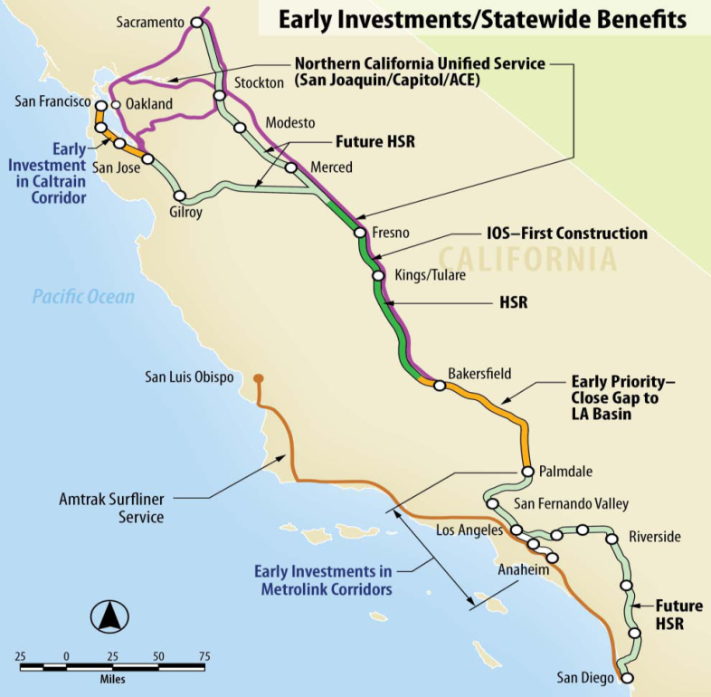
Focus on INCREMENTAL DEVELOPMENT OF AN Integrated passenger rail System
Blended systems, with integrated infrastructure investment
  High performance / high-speed rail
  Amtrak
  Commuter rail “bookends”
  Commuter and urban rail feeder services
  Multimodal hubs
Blended operations, with integrated service
Potential for connection to proposed P3 rail service to Las Vegas
Focus on shared use, coordination of service, interoperability, with selective exclusive use

Slide 24
Prioritization of Foundation Projects
Demonstrate early success
Address immediate mobility and congestion needs
Develop political support
Address funding realities
Examples:
  Transbay Terminal, San Francisco – California HSR, Caltrain, MUNI, BART rail and bus
  Los Angeles Union Station / SCRIP – California HSR, Amtrak, Metrolink, Metro rail and bus
  Anaheim ARTIC Station – California HSR, Amtrak, Metrolink, OCTA bus, streetcar

Slide 25
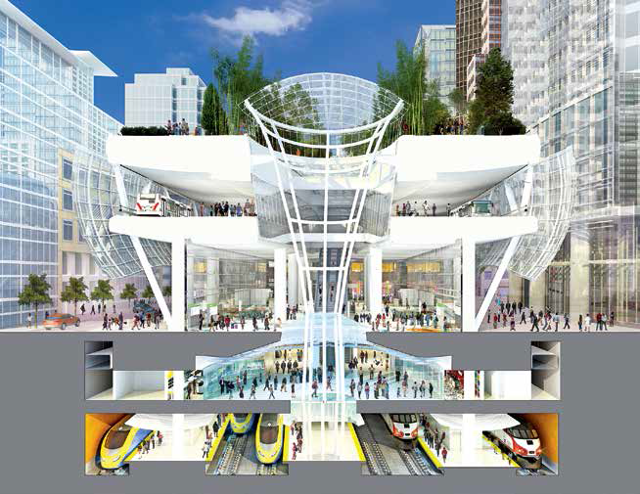

Integrated Federal, State, regional, and Local Funding and financing
Transbay Transit Center
Financing Instruments (TIFIA, RRIF, SIB)
Grants
Existing
Speculative
Dedication of Incremental Tax Revenues
Joint Develop-ment
Sales Taxes
Lodging Tax
Levy on Property Tax
Federal (limited)
State
MTC
SFCTA

Slide 26
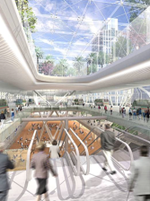
Ancillary Revenue Sources
Station leases and concessions
    Food and beverage
    Rail
    Mobility services
Advertising
    Traditional
    Wrapping, domination
Naming rights
Air rights development
Parking revenues
Access fees
Sharon Greene, Principal, Sharon Greene and Associates, USA
Sasha Page, Vice President, Infrastructure Management Group, USA
July 11, 2012, Network Planning

Slide 27
Public-Private Partnership opportunities
Achieve accelerated project delivery
  Project activities in “parallel”
Insure project quality throughout life cycle
  Private financial participation (“skin in the game”)
Reduce risks
  Eliminate/lessen risk of project cost overruns/change orders
  Reduce public sector risks by strengthening project interfaces
Achieve cost savings
  Operations - performance-related concessions and system availability-based contracting
  Capital - design and construction efficiencies
Enhance cash flows
  Private financing mechanisms
  Leverage Measure R revenues and other public funding sources
Utilize new funding sources
  Value creation and user revenue streams (e.g., transit-oriented development, road tolls)
  Federal financing sources (TIFIA)

Slide 28
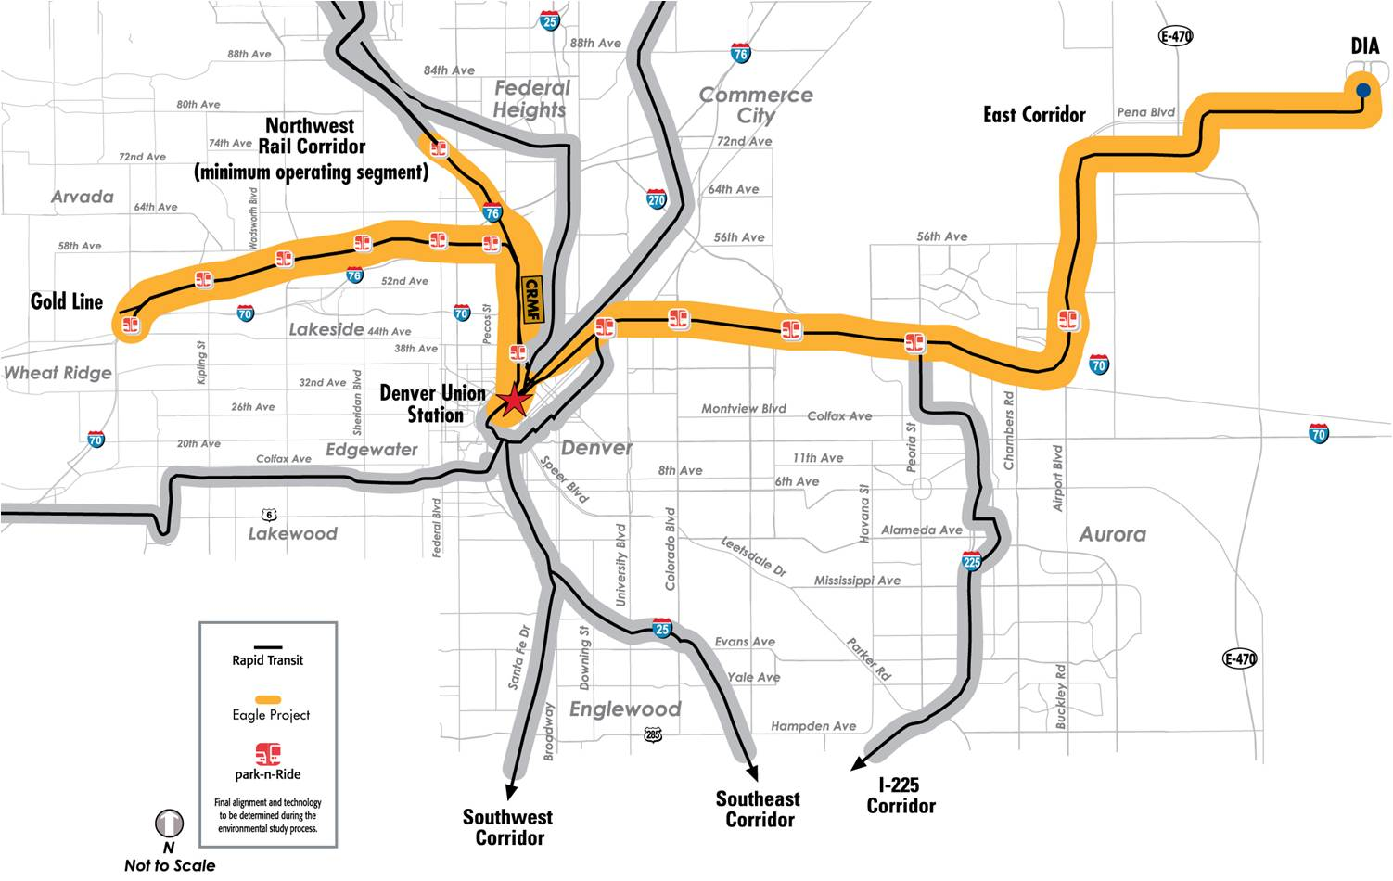
Denver RTD Eagle P3 Project
  $2.1 billion PPP project providing 35 miles of new commuter rail system
    $1 billion FTA New Starts
    $486 million private financing
    TIFIA and RRIF loans from US DOT
Delivery method is Design/ Build/ Finance/ Operate/ Maintain (DBFOM)
  Availability payments to be made over 33 year Concession (4 + 29 for O&M) from RTD sales tax revenues

Slide 29
Funding california’s passenger rail systems
Incrementally enhance and develop high performance corridors
Integrate federal, State, regional, and local funding
Identify opportunities for value capture
Seek ancillary revenue sources
Leverage innovative finance
Assume initial funding will be public
Pursue opportunities for private sector involvement

Slide 30
QUESTIONS

