Slide 1
ACEforward
ACEforward
Stacey Mortensen
Executive Director
San Joaquin Regional Rail Commission
Rail Summit April 29, 2015
Notes:
Dan - Introductions

Slide 2
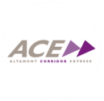
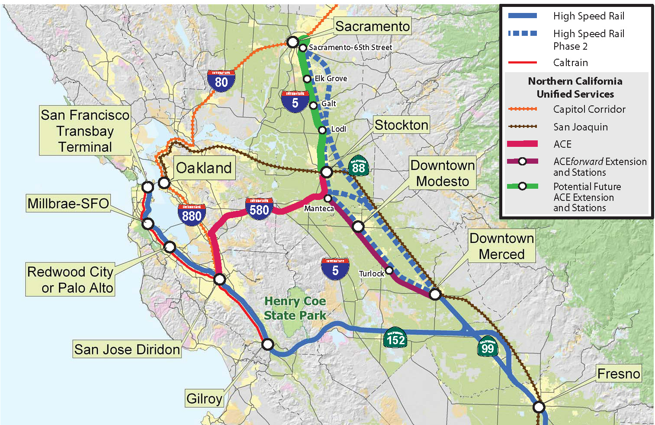
The New ACEforward Initiative
Notes:
Tell story of refined vision of corridor; how we got from one project to the next. We are making progress in this corridor.
Initial work that started in 2008 under x premise; very big picture; very big project; now focusing on the near-term improvements to get started. Zooming into fundable local improvements; doesn’t preclude the long-term vision, but now focusing on the near-term. The prior work effort was looking at a wholly new train line through this corridor. With what we learned in our studies, shaped the new project.
Start with map that shows the ultimate 10 years out, showing ACE going to Modesto and Merced
Then show existing

Slide 3
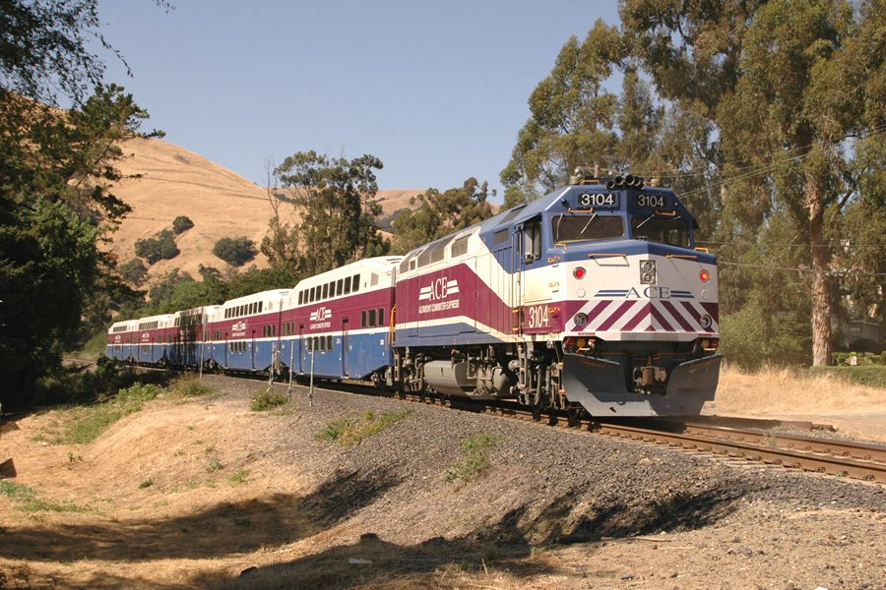
ACE Train – Niles Canyon Area
Notes:
Lathrop/ Manteca

Slide 4
Current ACE - 2014
Notes:
Lathrop/ Manteca

Slide 5
ACEforward Project Goals 5-year plan – 2018
Stockton - Modesto
Extension to Modesto
Altamont Corridor
Safety & Operational Improvements
Increase Service to 6 Daily Round Trips
Notes:
Levi’s Stadium/ Great America

Slide 6
ACEforward Project Goals Ten-Year Plan - 2022
Stockton - Merced
Extension to Merced
Altamont Corridor
Increase Service to 10 Daily Round Trips
Notes:
Levi’s Stadium/ Great America

Slide 7
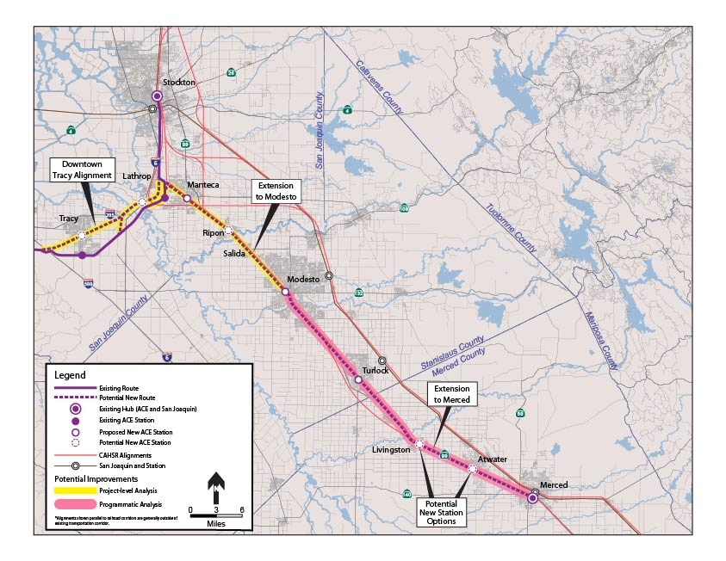
San Joaquin Valley Alternatives
River Islands:
Commerce Blvd/ Employment Center
Manteca: Main Street/Moffat Blvd
Ripon:
Main Street/ 2nd Street
Kiernan Avenue
Modesto:
I - K Streets
Turlock: Main Street
Tracy:
E. Sixth Street/ N. Central Ave.
Atwater: N. Winton Way/ Atwater Blvd
Kiernan Avenue
Merced: MLK – G Street
Proposed HSR Station
Livingston: Main Street
Notes:
Initial Alternatives:
Grade Crossing Improvements
Safety
Noise Mitigation
Options for extension to Modesto and Merced
Additional track within UPRR
Stations
Alternatives to increase service to 6 daily round trips (San Jose – Stockton)
Grade separations
Sidings
Tunnel at Altamont Pass Summit (time savings as it straightens route)
Options for connecting with BART
Union City
Livermore

Slide 8
ACEforward – Ridership Forecast – Merced Extension
No-build ridership forecast to increase by more than 25% by 2025
The highest long-term annual ridership could be up to 5.9-million riders, an increase of more than more than 340% compared to today’s usage
5.9
2.25
1.33
14
Notes:
Update slide numbering.
Add numbers to top of the bars (1= grey 2015, 2= blue 2020, 3= purple 2025)
2025 Ranges:
6 Daily Round Trips (Extend to Modesto)
Low = 2 trains Modesto, 4 trains Stockton
High = 6 split trains Modesto and Stockton
10 Daily Round Trips (Extend to Merced)
Low = 6 trains Merced, 4 trains Stockton, weekend service, no HSR, no BART
High = 8 split trains Merced and Stockton, plus 2 Stockton, with weekend service, HSR and direct BART connection at Greenville Road

Slide 9
ACEforward – Station Activity Level
15
Notes:
Low = 6 trains Merced, 4 trains Stockton, weekend service no HSR, no BART

Slide 10
ACEforward – Station Activity Level
16
Notes:
High = 8 split trains Merced and Stockton, plus 2 trains Stockton, with weekend service, HSR and direct BART connection at Greenville Road

Slide 11
Altamont Corridor Capital Improvements
Section | Project Cost ($-MM 2014) | Local Share* ($-MM 2014)
Extension to Modesto San Joaquin County ⁽¹⁾ Stanislaus County | $102.8 $96.2 | $25.7 $24.1
5th & 6th Train ⁽²⁾ | $202 | $50.5
Extension to Merced Stanislaus County ⁽³⁾ Merced County | $122.5 $227.2 | $30.6 $56.8
7th – 10th Train ⁽²⁾ | $200 | $50
1 – Extension to Ripon
2 – Capacity and grade crossing improvements Stockton – San Jose section & maintenance facility expansion
3 – Extension to Turlock
4 – Capacity improvements Stockton – San Jose section
Approx. $11.0M/mi

Slide 12
ACEforward Schedule
Notes:
Talk about this as 10-yr plan

Slide 13
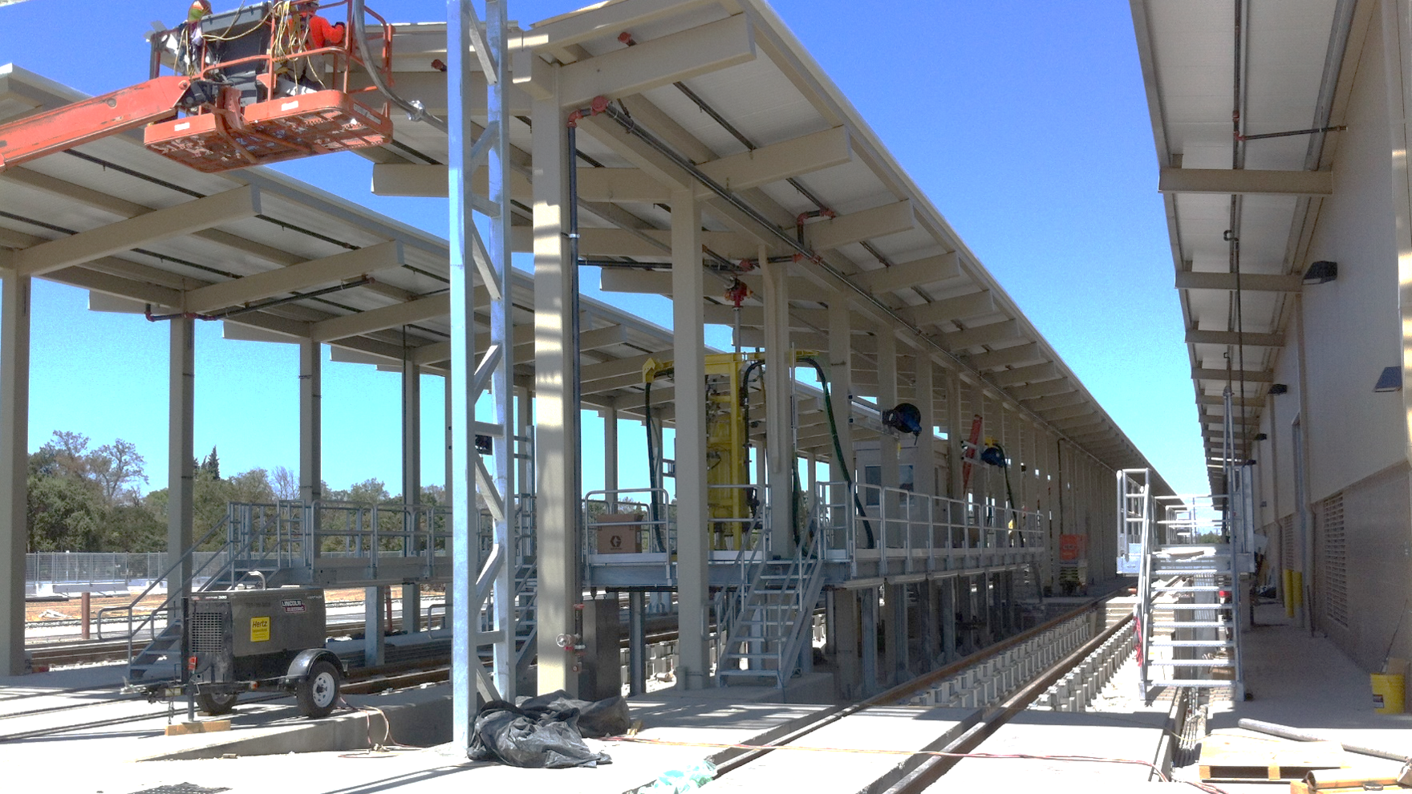

Slide 14
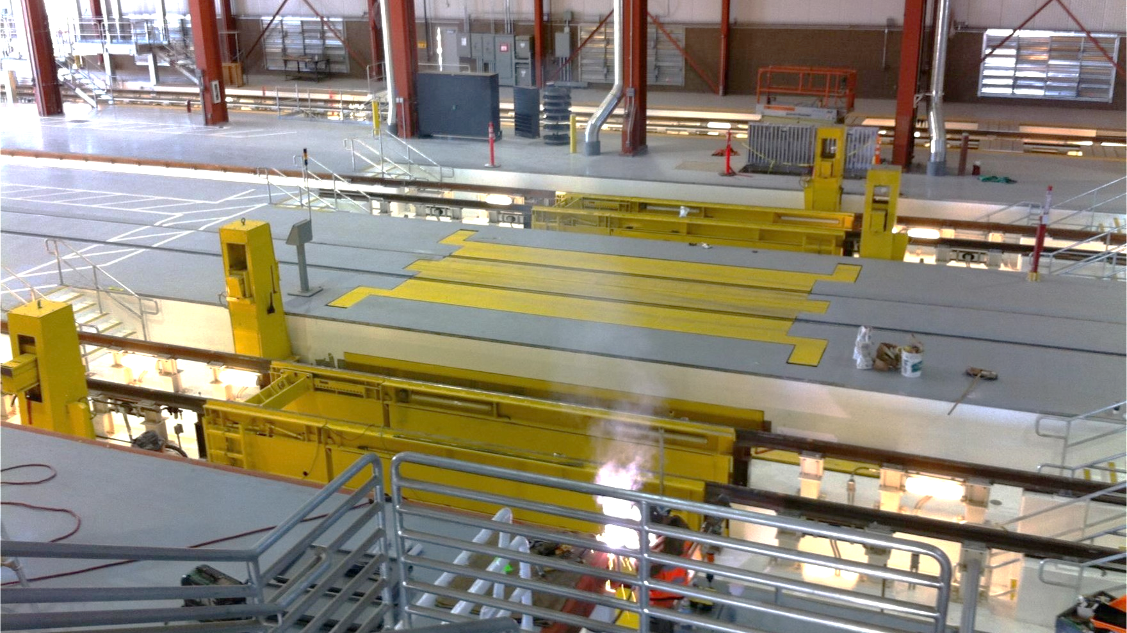

Slide 15
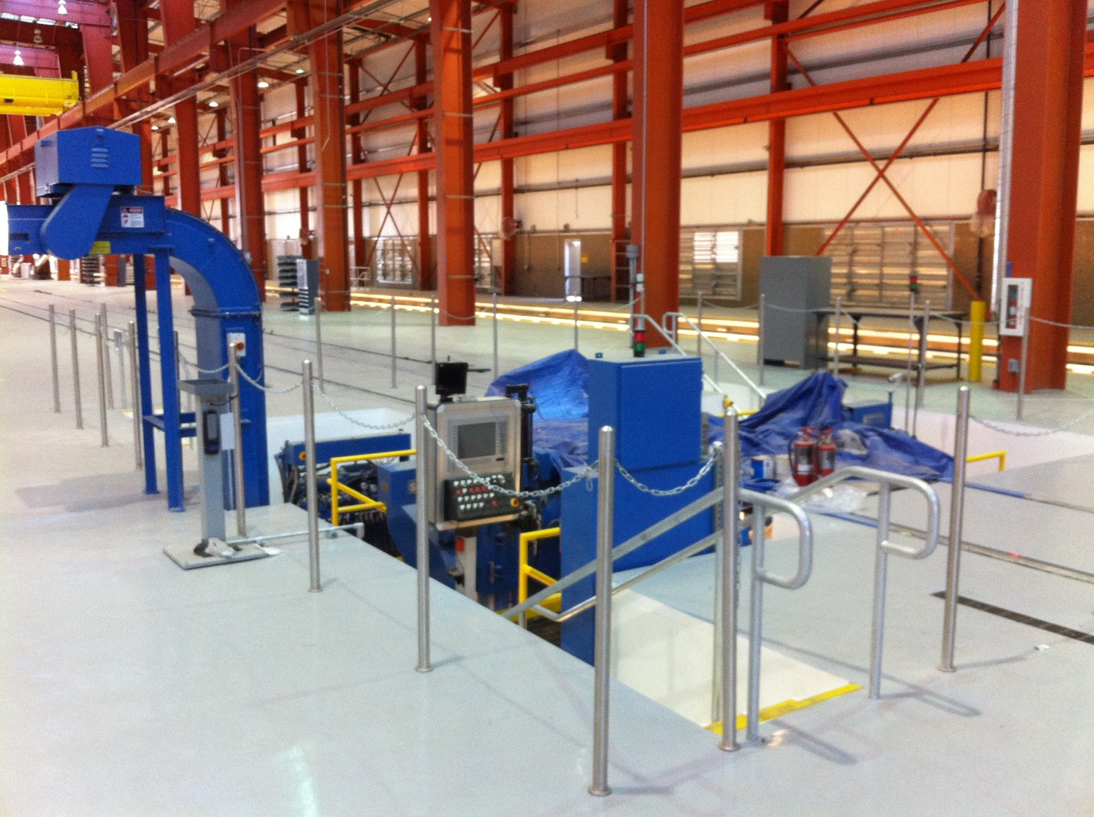

Slide 17
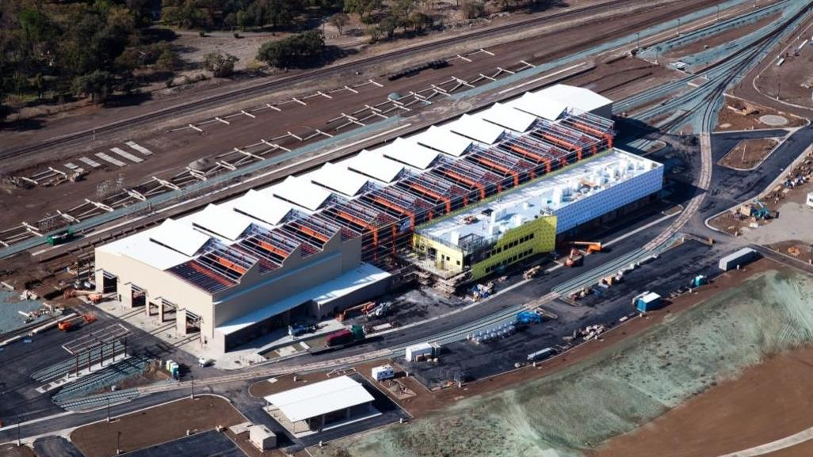

Slide 18
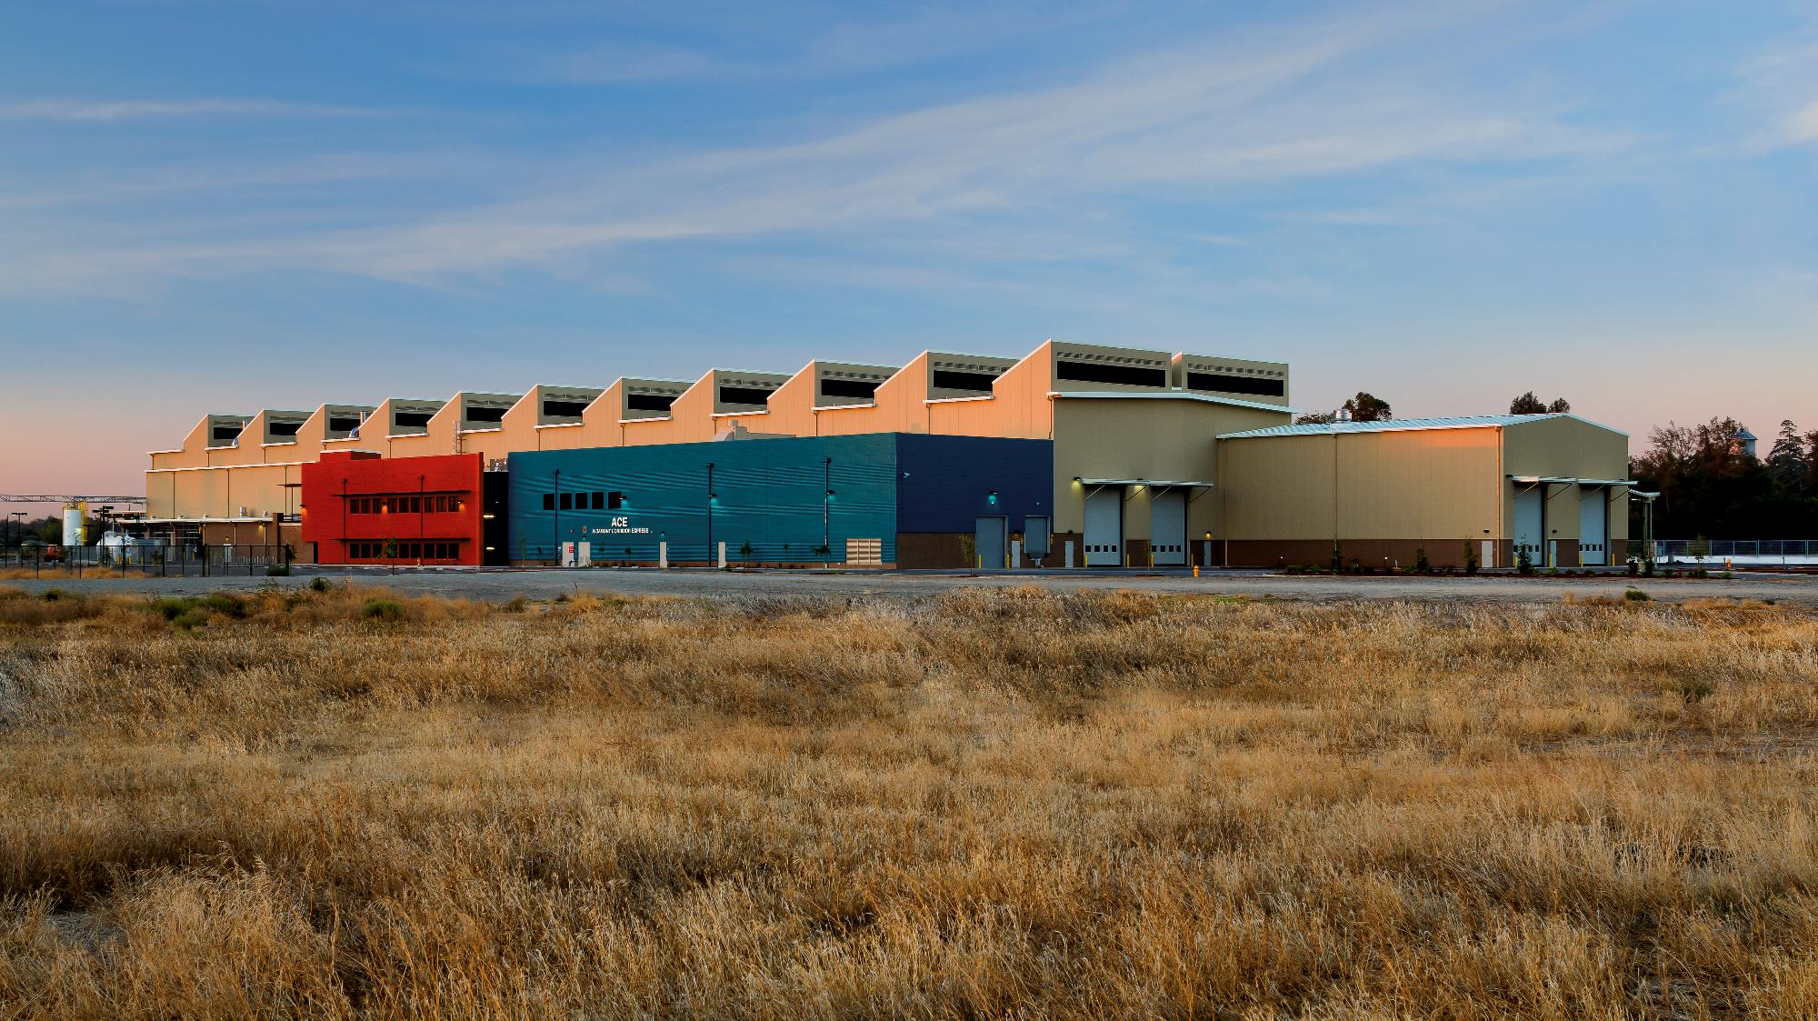

Slide 19
Rail Summit April 29, 2015

Slide 20
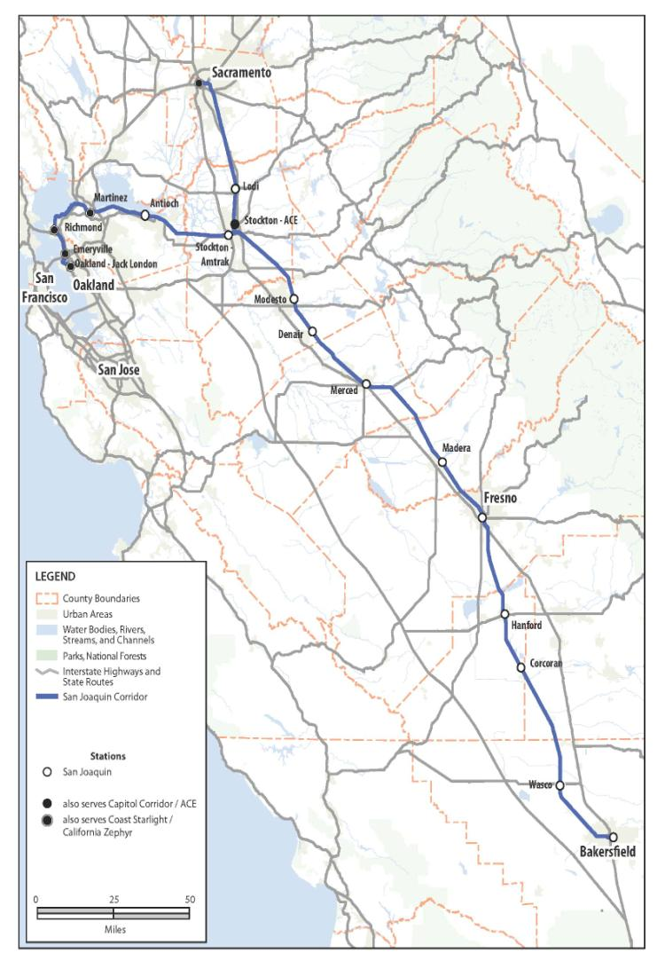
San Joaquin Service
364 miles
11 counties
17 stations
6 daily round trips
4 Oakland – Bak
2 Sac – Bak

Slide 21
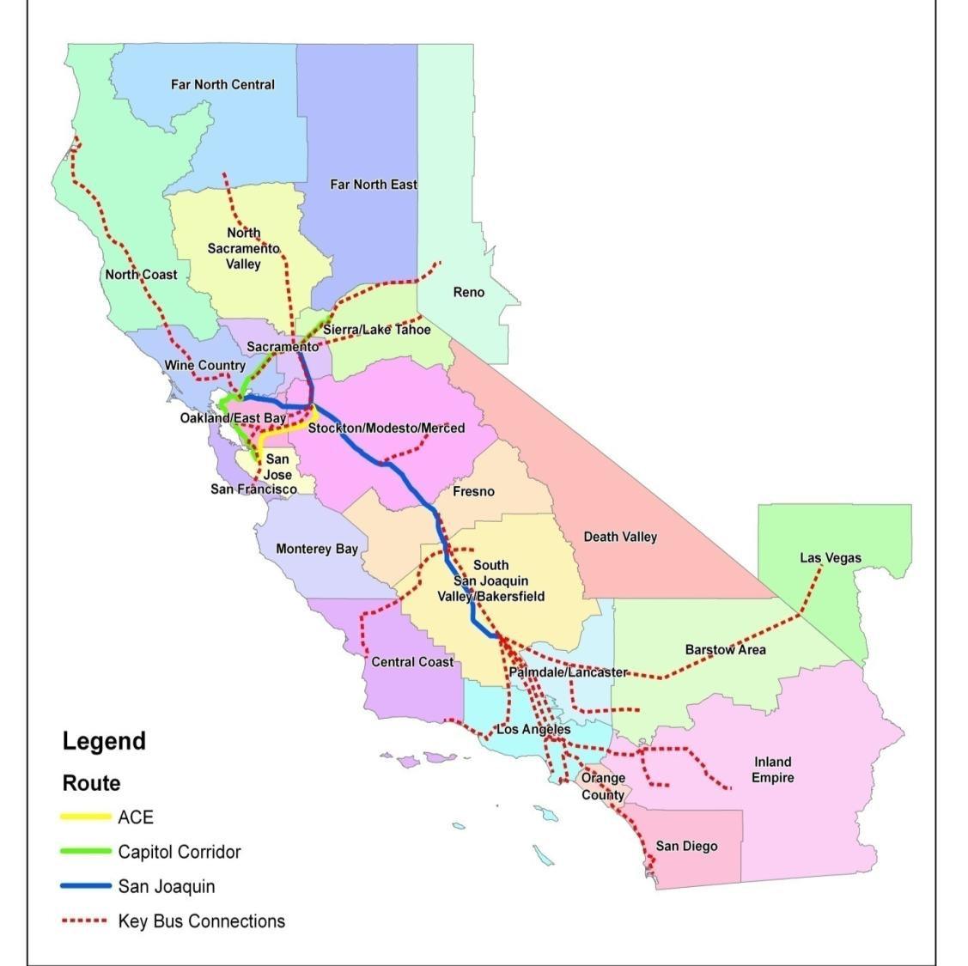
Notes:
The extensive network of dedicated Amtrak Thruway buses connecting with the San Joaquin is critical to the performance of this service.
Thruway bus service connections in Bakersfield, Sacramento, Stockton, Oakland, Emeryville, Martinez, Merced, and Hanford
Caltrans contracts with Amtrak for dedicated feeder bus services, and Amtrak then contracts with bus operators.
In 2012, nearly 45 percent (510,793) of San Joaquin passengers used an Amtrak Thruway bus on at least one end of their trip.
All trains either initiating or terminating at Bakersfield are met by Amtrak Thruway buses connecting south to Southern California.
In FY 2012, over 318,000 San Joaquin passengers used a Amtrak Thruway bus between Bakersfield and Southern California, with over half of these passengers traveling to/from LAUS

Slide 22
San Joaquin Trainset

Slide 23
Looking Ahead
Deployment of the 7th daily round trip is the highest priority for service expansion.
SJJPA will work with the State to secure the funding necessary for the capital improvements and the additional operating funds to enable the deployment of the 8th daily round trip.
Pursue improvements to increase frequency of service to Sacramento.
Notes:
SJJPA will focus advocacy efforts on securing the required increase in state operating funds for the 7th daily round trip…improvements for the 7th daily round trip are funded and under construction. Expected to be completed by mid to late 2015.
$10-12 million is needed for operating funding for the 7th daily round trip and $10-12 million for the 8th daily round trip
The State needs to secure an additional $112 million in capital costs for the 8th daily round trip.

Slide 24
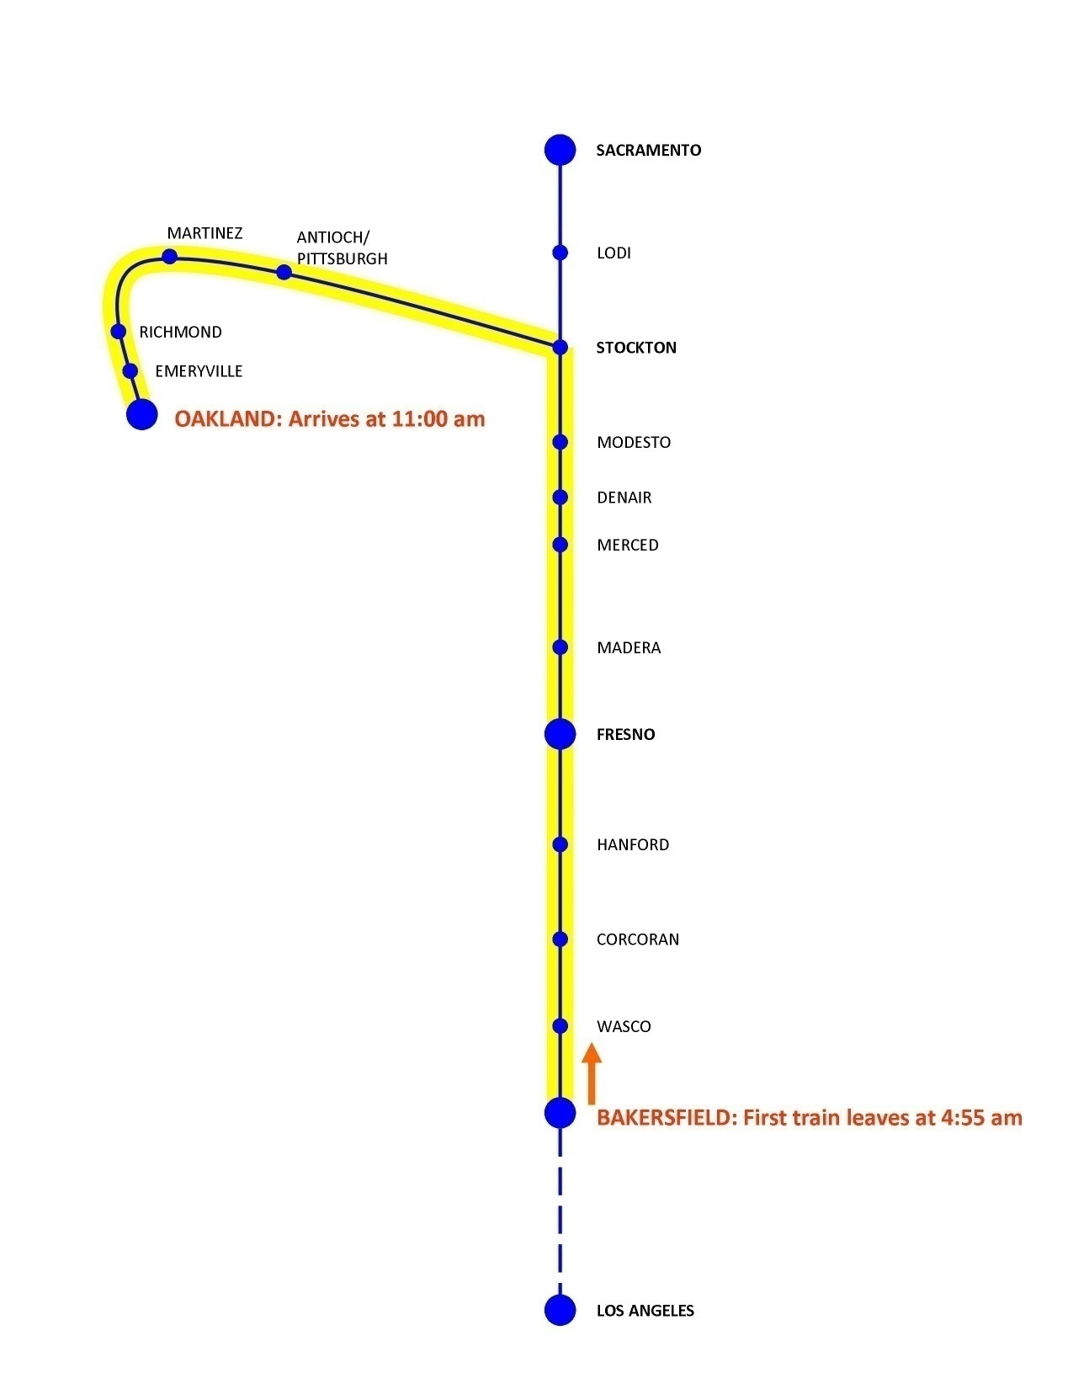
Notes:
Initiating early San Joaquin trains mid-corridor and having the last San Joaquin trains end mid-corridor may result in substantial increases in ridership and revenue.
The SJJPA will work with Caltrans, BNSF and UPRR to evaluate the possibility of having the 7th and 8th daily round trips be used by San Joaquin trains which start and end-mid corridor.
The first daily trip to Sacramento arrives at 12:30 am and the first trip from Oakland to Bakersfield arrives in Bakersfield at 12:02 pm.

Slide 25
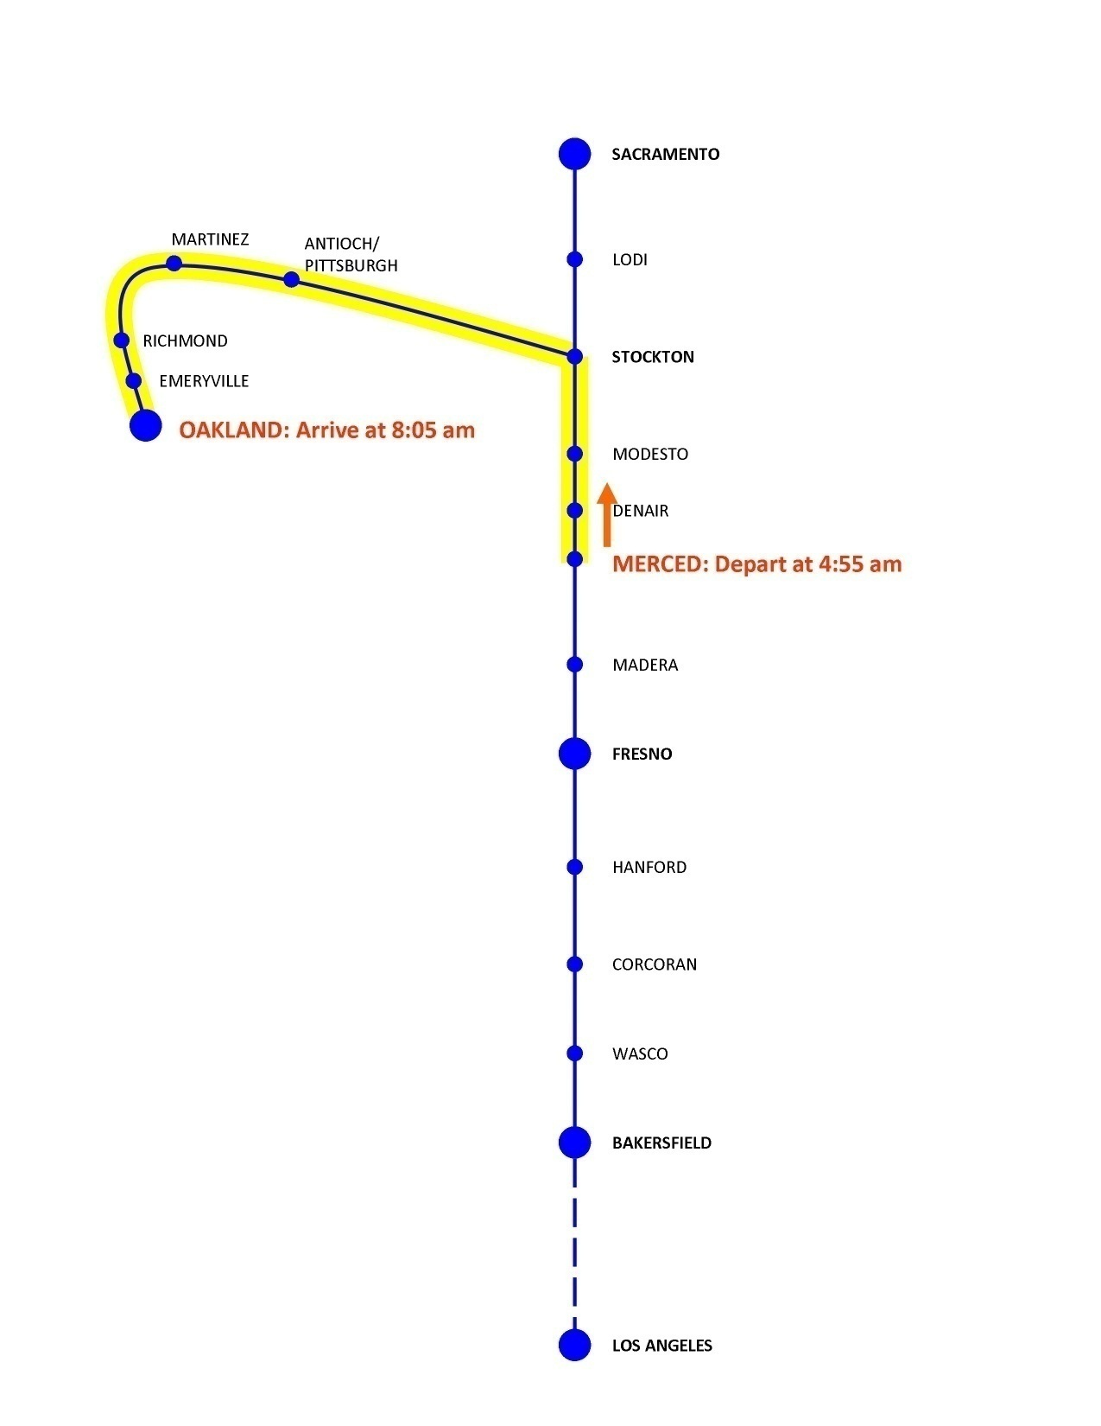

Slide 26
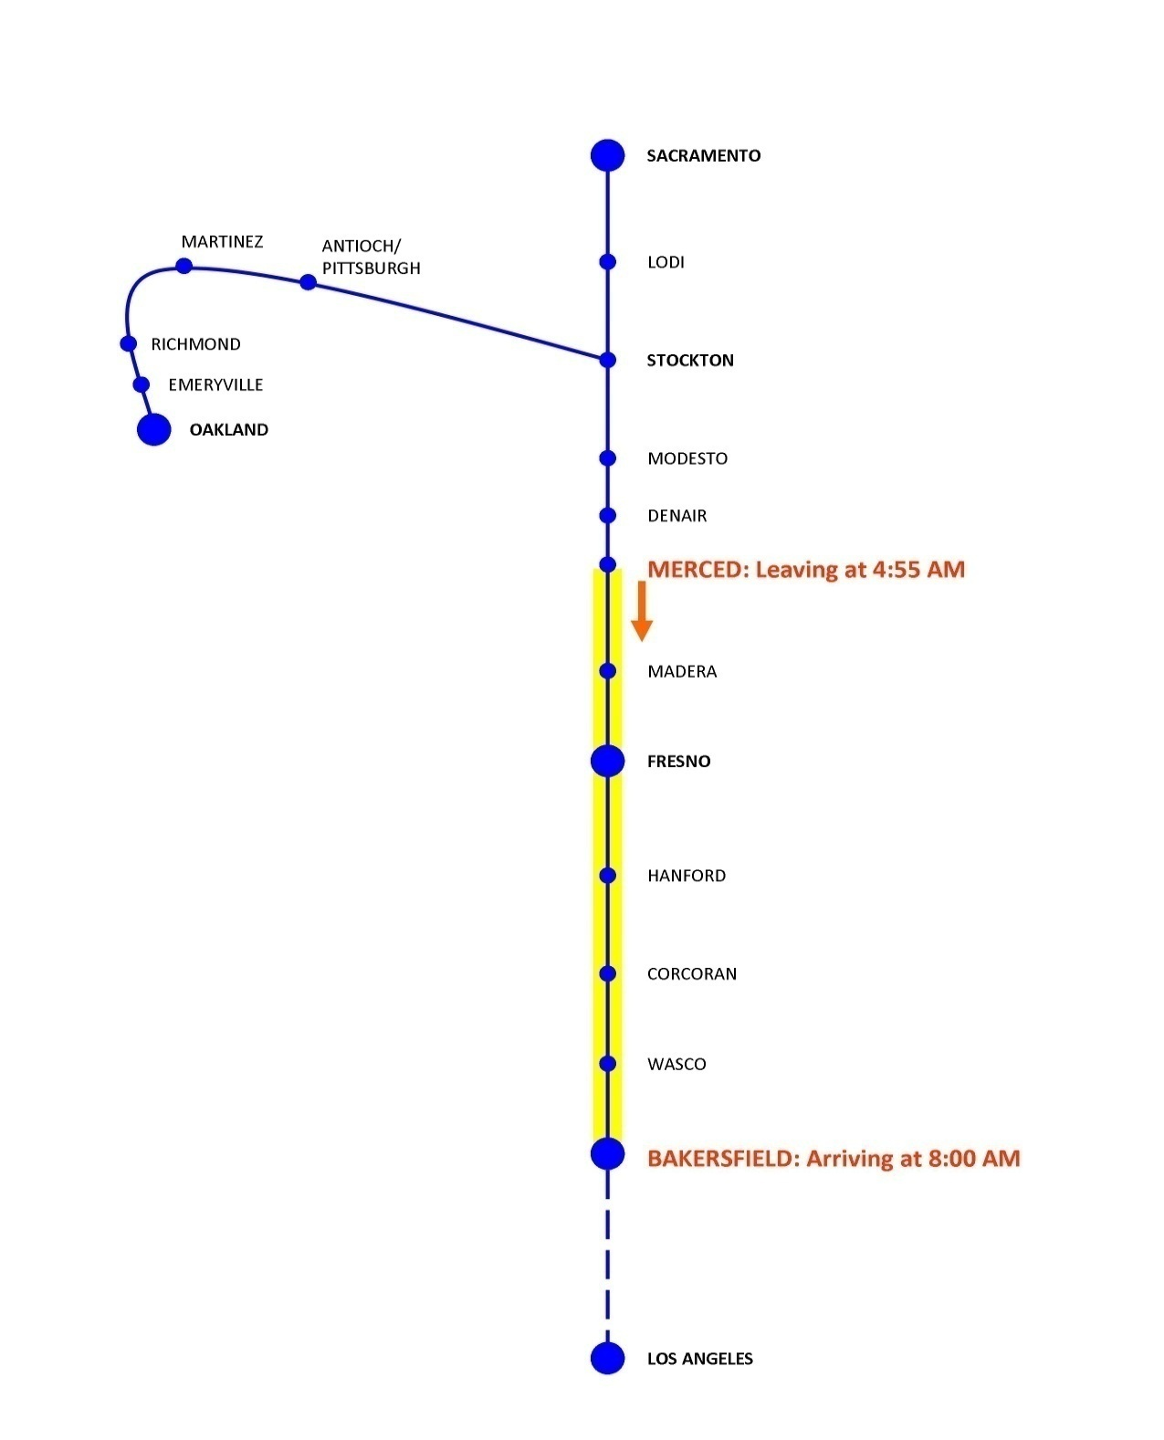

Slide 27
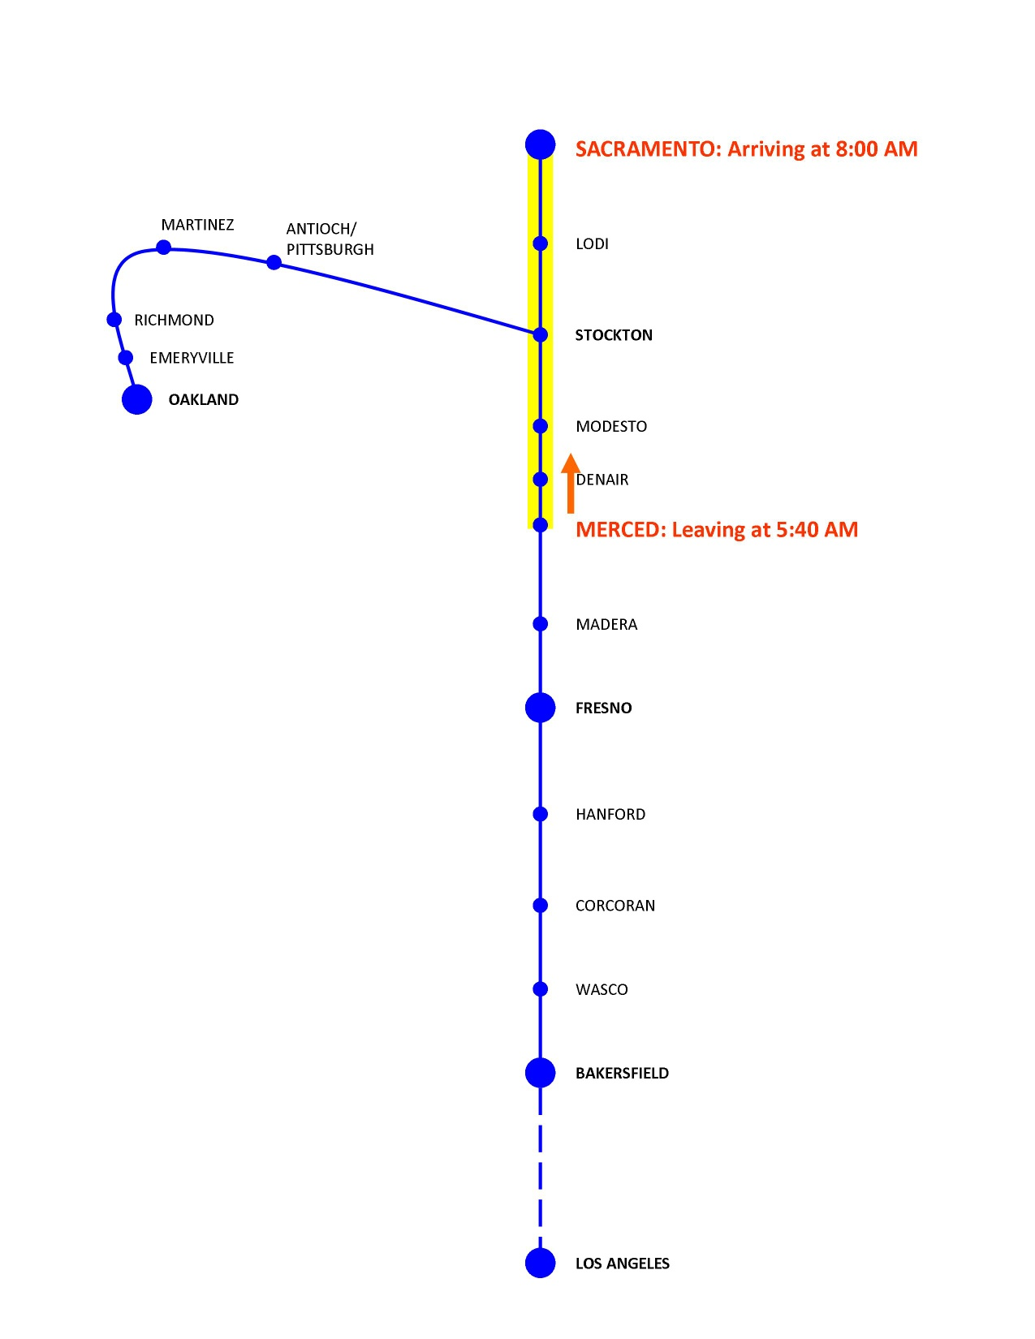
Notes:
There is a great potential market for the San Joaquin service to Sacramento if the frequency can be increased and offered at the right time of day.
SJJPA will work with the State, freight railroads, and CVRWG to pursue improvements of the San Joaquin service to Sacramento.

Slide 28
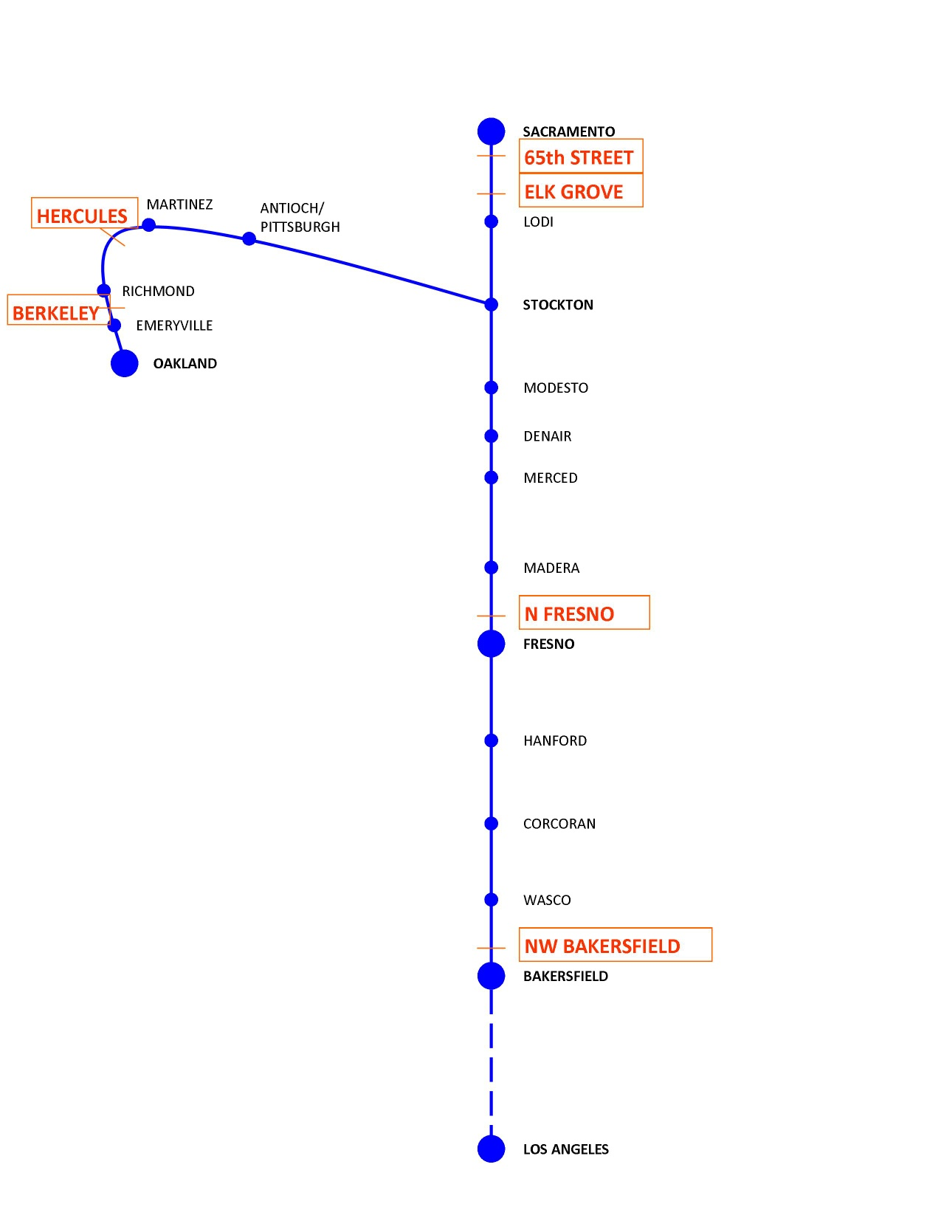

Slide 29
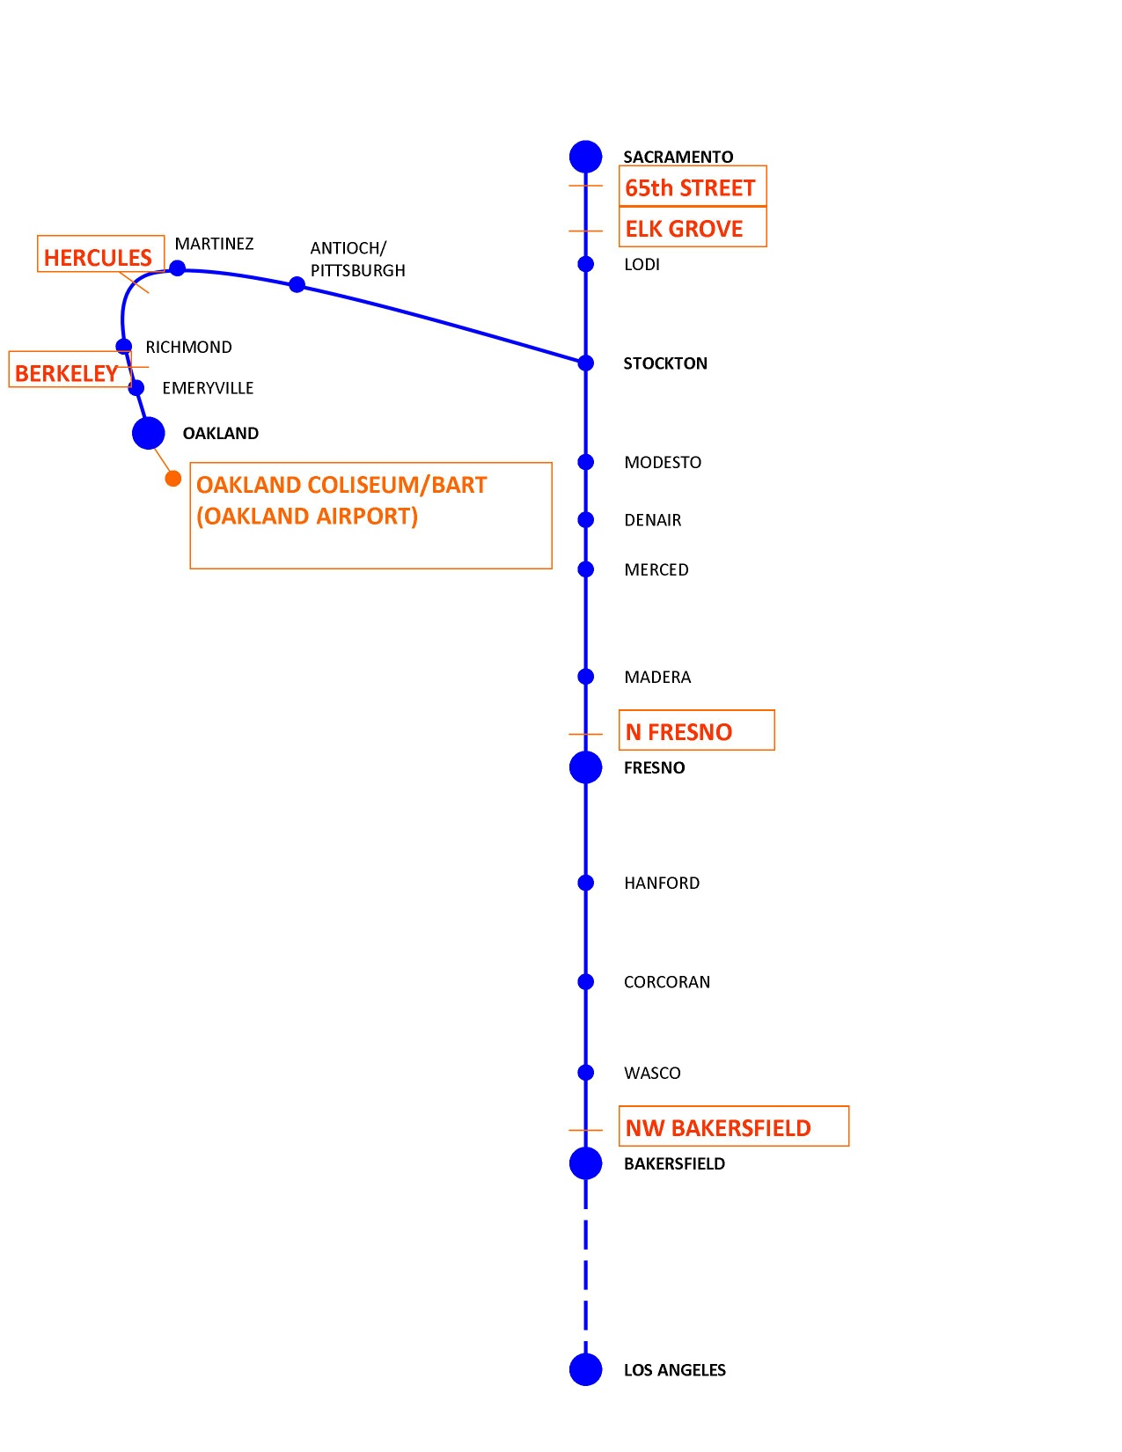

Slide 30
San Joaquin Joint Powers Authority
Next Board Meeting, May 15, 2015 at Stockton (555 E. Weber Ave.), at 12:30 pm
Approve 2015Business Plan Update
Approve Interagency Transfer Agreement
Transfer of San Joaquin Service Management by July 1, 2015
www.acerail.com/sjjpa

Slide 31
San Joaquin Joint Powers Authority
Know the San Joaquin Corridor Advocates/Decision makers:
John Pedrozo, Merced County, Chair
Henry Perea, Fresno County, Vice Chair
Don Tatzin, City of Lafayette, Vice Chair
Patrick Hume, City of Elk Grove
Vito Chiesa, Stanislaus County
Tom Blalock, Alameda County
Allen Ishida, Tulare County
Bob Johnson, City of Lodi
Doug Verboon, Kings County
David Rogers, Madera County

Slide 32
Rail Summit April 29, 2015

